Slide 1

Webinar Housekeeping – please read!
As this is a webinar we ask all participants to please note the following:
MOBILE PHONES are to be either switched off or switched to silent
SPEAKER VIEW: if you could please switch your screen to SPEAKER VIEW. To do this, take your mouse and hover over your screen and to the top RIGHT corner of your screen please click SPEAKER VIEW.
MORNING TEA: Morning Tea will be at 11.30am for 20 min
The Webinar will conclude at 1.30pm and will follow with Q&A for 15 minutes for those participants that have further queries of our presenter
QUESTIONS: This is an interactive Webinar and you are encouraged to please ask any questions that you may have of our presenter, Ross. To ask a Question, please hover over your screen with your mouse and click on the UNMUTE button. Once you have asked your question, please click MUTE – to avoid any background noise from entering the Webinar. You may also hold down your space bar to ask your question and release it after you have asked your question. Ross and the AEBN team will be here to assist you.
THANK YOU!

Slide 2

AEBN SERIES 1: Dangerous Goods, Hazardous Substances and GHS Workshop Webinar
17 September 2025
Presented by
Australian Environment Business Network (AEBN) www.aebn.com.au

Slide 3


Zoom Tips!
Double click your screen for Full Screen Mode.
When in Full Screen Mode, hover over the top of the participants bar to change your view of other participants.
To Ask Questions: When on mute, hold down the SPACE BAR to temporarily unmute yourself.
Look at the bar at the bottom of your screen for additional options.
Full screen mode
Recommended speaker view

Slide 4


Ross Macfarlane
National Chemicals Specialist
Australian Environment Business Network (AEBN)
Ross has over 35 years experience in chemical safety – specifically in dangerous goods and hazardous substances.
Ross’ specialty is in risk management, in particular, in occupational health and safety, environmental and quality management (OHSEQ). His experience covers such industries as chemical and petrochemical, mining and metals, automotive, manufacturing, timber, pulp and paper, construction, aviation, local government, roads, and the health sectors. www.aebn.com.au

Slide 5
Agenda
Hazardous substances and dangerous goods
  Legal compliance framework
Safety Data Sheets
Hazardous Substances
  Approved Criteria vs. GHS
  Globally Harmonised System
  GHS Labelling
Dangerous Goods
  Terminology
  Classes
  Packaging
Storage and Handling
Road and Rail Transport
Notes:
5

Slide 6
Objectives
To be able to identify and be aware of the hazards of Dangerous Goods
To make the Storage and Handling of Dangerous Goods safer
Understand the Regulations and the Dangerous Goods terminology
Your responsibilities
Packaging and Labeling
Segregation
Notes:
6

Slide 7
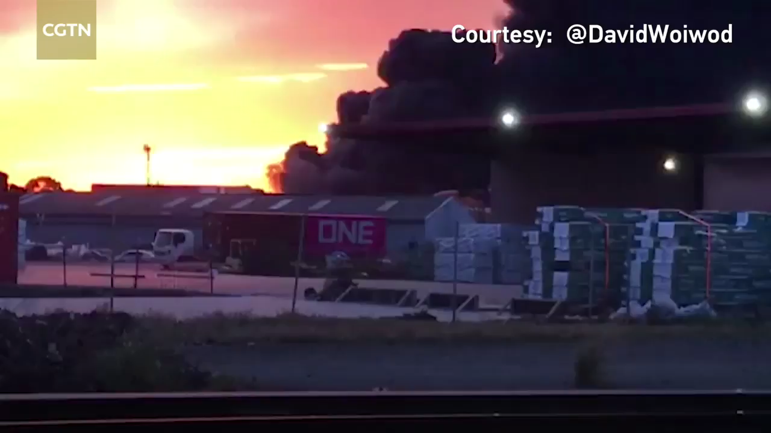
Why it matters?

Slide 8
Australia has separate Legislation covering
Dangerous Goods
Hazardous Substances
Hazardous Chemicals
Major Hazard Facilities
Explosives
Security Sensitive Chemicals
Scheduled Poisons
Pharmaceuticals
Agricultural Chemicals
Today’s focus
Notes:
8

Slide 9
Dangerous Goods vs. Hazardous Substances vs. Hazardous Chemicals
The term “Dangerous Goods” applies to chemicals which present immediate hazards during transport, and in Victoria and Western Australia, during storage and handling.
  In other States, “Dangerous Goods” in storage and handling are technically known as “Schedule 11 Hazardous Chemicals”
  In New Zealand, DG storage and handling falls under Hazardous Substances regulations
“Hazardous Substances” are classified under GHS based on a wider range of hazards, including harm to people during short and long-term exposure, and harm to the environment.
  In states other than VIC, these are called “Hazardous Chemicals” in the workplace.
Notes:
9
Example of a dangerous good.
Flammable Liquid
Explain what a flash point is and its impact on how dangerous a chemical will be
All dangerous goods have a un number. If they do not then they are not a dangerous good.

Slide 10
Dangerous Goods vs. Hazardous Substances vs. Hazardous Chemicals (Cont…)
It is confusing!
In this workshop, I will mainly use Victorian terminology, i.e.
  Dangerous Goods – as classified under the Australian Code for the Transport of Dangerous Goods by Road & Rail (ADG Code), whether in the workplace or during transport
  Hazardous Substances – as classified under the Globally Harmonized System for the Classification and Labelling of Chemicals (GHS)
Notes:
10
Example of a dangerous good.
Flammable Liquid
Explain what a flash point is and its impact on how dangerous a chemical will be
All dangerous goods have a un number. If they do not then they are not a dangerous good.

Slide 11
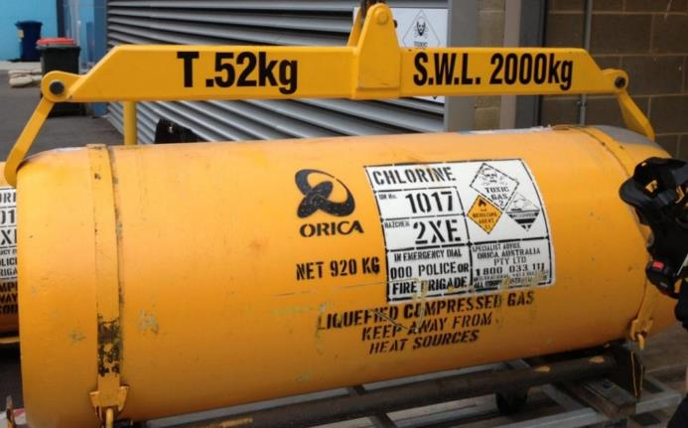
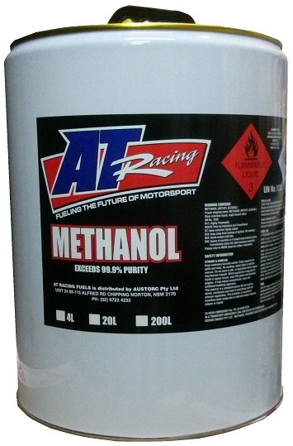
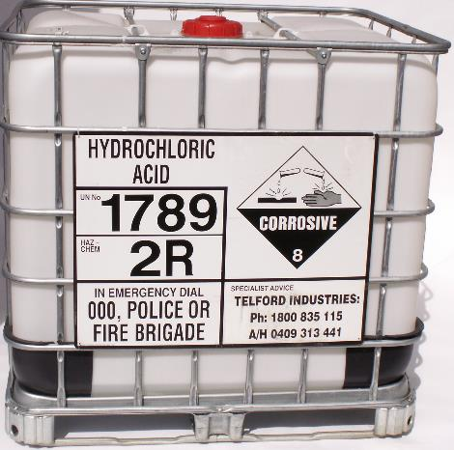
Hazardous Substances that are Dangerous Goods

Slide 12
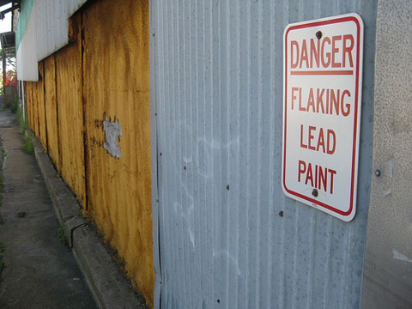
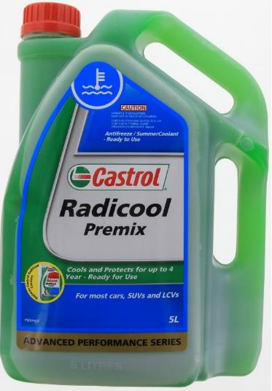
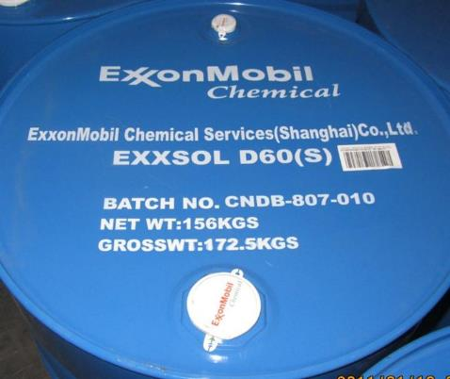
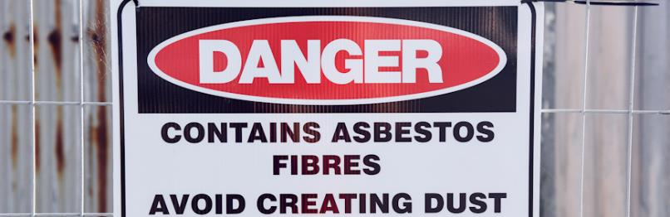
Hazardous Substances that are not Dangerous Goods

Slide 13

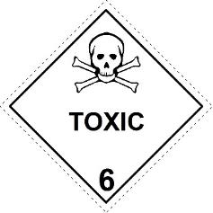
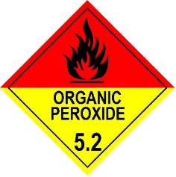
Dangerous Goods
Substances which constitute a hazard from explosion, fire, toxicity, corrosivity or radioactivity
and
Which are identified by Class Labels
and
Have a UN Number
Notes:
13

Slide 14
What are Dangerous Goods?
Substances which pose a physical threat to
  Persons
  Property
  The environment
From
  Explosion
  Fire
  Poisoning
  Corrosion
  In most cases they pose a short-term risk
Notes:
14

Slide 15



What are Hazardous Substances?
Can pose both short and long-term risks:
Physical hazards
    Explosion
    Fire
    Poisoning
    Radioactivity
    Corrosion
Environmental hazards
    To aquatic life
    To terrestrial vertebrates
    Ozone depleting
Health hazards
    Very toxic
    Toxic
    Harmful
    Corrosive
    Irritant
    Carcinogenic – cause cancer
    Mutagenic – cell mutation
    Sensitising – allergic reactions
    Teratogenic – birth defects
Notes:
15

Slide 16
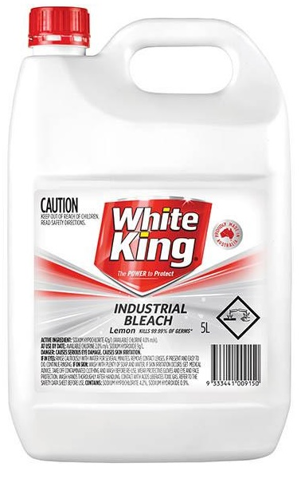
White King bleach
Dilute sodium hypochlorite (“pool chlorine”)
  Is not a Dangerous Good
Can cause eye damage and skin irritation
  Is a Hazardous Substance
Notes:
16

Slide 17

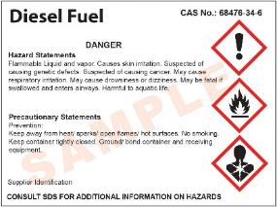
Diesel fuel
Has a high flashpoint – will not ignite easily
  Is not a Dangerous Good
Can cause dermatitis and will irritate the eyes
  Is a Hazardous Substance
Notes:
17

Slide 18
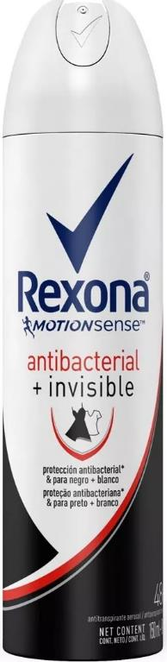
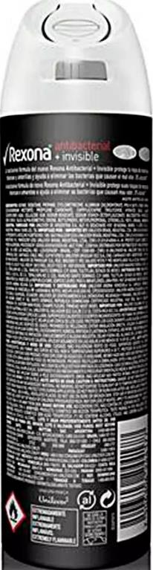
Rexona deodorant
  Flammable Gas of Class 2.1, UN 1950 (Aerosol)
  Is a Dangerous Good
  Is a Hazardous Substance (Physical hazard only)
Notes:
18

Slide 19


Benzene
Flammable Liquid of Class 3
  Is a Dangerous Good
Proven Carcinogenic Material
  Is a Hazardous Substance (physical and health hazard)
Notes:
19

Slide 20
Regulatory framework

Slide 21
Hazardous Substances
Hazardous Chemicals regulated in nationally harmonised Work Health & Safety (WHS) laws:
  ACT, NSW, NT, QLD, TAS, SA, WA, Commonwealth
  In VIC, Hazardous Substances are regulated under existing OHS Regulations
  WA adopted WHS laws in 2022, but Dangerous Goods remain outside

Slide 22
Storage & Handling of Dangerous Goods
In ACT, NSW, NT, QLD, SA and TAS storage and handling of Dangerous Goods is covered by WHS Regulations
  Referred to as “Schedule 11 Hazardous Chemicals”
In VIC and WA this is covered in Dangerous Goods legislation
Notes:
22

Slide 23
Dangerous Goods Transport
Not covered by the Work Health & Safety (WHS) regulations for hazardous chemicals.
These continue to be covered by state-based transport laws and the Australian Dangerous Goods (ADG) Code.

Slide 24
Australian Code for the Transport of Dangerous Goods by Road & Rail
ADG Code Issued by National Transport Commission (NTC)
  Reviewed 2-yearly
ADG7.8 (UN22)
  Can be used until 1 October 2025
  ADG 7.9 ( UN23)
  Adopted from 1 October 2024, mandatory from 1 October 2025
  Derived from UN Recommendations on the Transport of Dangerous Goods 23rd Edition (UN23)
  Separate comprehensive review of ADG Code in progress
Model Act For The Transport of Dangerous Goods by Road and Rail 2007
  Model Subordinate Law for the Transport of Dangerous Goods By Road And Rail
Other codes
  IMDG Code (sea transport)
  IATA Regulations (air transport)

Slide 25

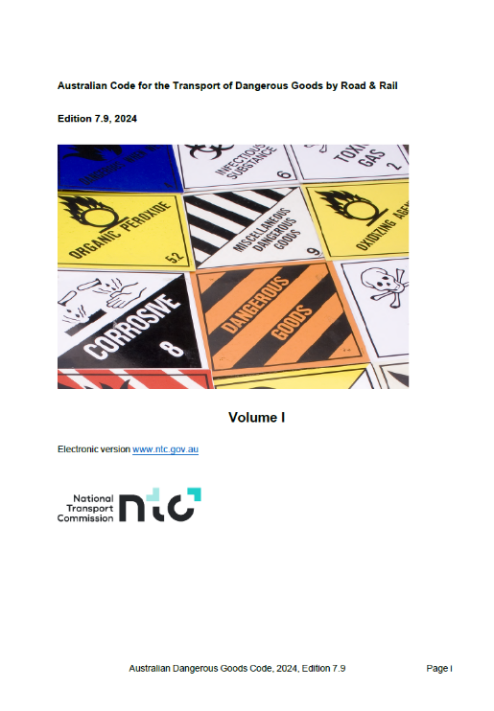


Slide 26
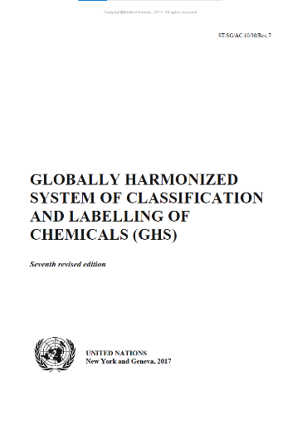

Hazardous Substances
Globally Harmonised System of Classification and Labelling of Chemicals (GHS)
  Edition 3 adopted 1/1/2012, mandatory 1/1/2017
  Edition 7 mandatory as of 1/1/2023
National Codes of Practice
  Managing Risk in the Workplace
  Labelling
  Safety Data Sheets

Slide 27
Regulation – Victoria
Dangerous Goods
Dangerous Goods Act 1985
  Dangerous Goods (Storage & Handling) Regulations 2022
    Code of practice for the storage and handling of dangerous goods 2013
  Dangerous Goods (Road & Rail Transport) Regulations 2018
  Dangerous Goods (Explosives) Regulations 2022
  Dangerous Goods (HCDG) Regulations 2016
Hazardous Substances
Occupational Health & Safety Act 2004
  Occupational Health & Safety Regulations 2017 PART 4.1—HAZARDOUS SUBSTANCES
    Compliance code: Hazardous substances

Slide 28

Regulation – NSW
Dangerous Goods
Dangerous Goods (Road and Rail Transport) Act 2008 (NSW)
  Dangerous Goods (Road and Rail Transport) Regulation 2022
Storage & handling EXCLUDED
Hazardous Substances
Work Health and Safety Act 2011 (NSW)
  Work Health and Safety Regulation 2017 Part 7.1 Hazardous chemicals
  Division 3 Subdivision 2 Manifest of Schedule 11 hazardous chemicals (equivalent to Dangerous Goods storage & handling)
National Codes of Practice
  Managing Risks of Hazardous Chemicals in the Workplace
  Labelling of Workplace Hazardous Chemicals
  Preparation of Safety Data Sheets for Hazardous Chemicals

Slide 29


Regulation – WA
Dangerous Goods
Dangerous Goods Safety Act 2004
  Dangerous Goods Safety (General) Regulations 2007
  Dangerous Goods Safety (Storage and Handling of Non-explosives) Regulations 2007
    Guide – Dangerous Goods Safety (Storage and Handling of Non-explosives)
  Dangerous Goods Safety (Road and Rail Transport of Non-explosives) Regulations 2007
Hazardous Substances
Work Health and Safety Act 2020 (WA)
  Work Health and Safety (General) Regulations 2022 Part 7.1 Hazardous chemicals
    Approved code of practice – Managing risks of hazardous chemicals in the workplace

Slide 30

Regulation – New Zealand
In NZ Dangerous Goods transport is covered by the Land Transport Rule: Dangerous Goods 2005
  Administered by NZ Transport Agency
Requirements are set out in New Zealand Standard NZS 5433:2020, Transport of dangerous goods on land
  SNZ HB 5433:2021 UN dangerous goods list (published 28/01/22)
Storage and handling of Hazardous Substances, including Dangerous Goods, is covered by Health and Safety at Work (Hazardous Substances) Regulations 2017
  Administered by WorkSafe New Zealand
4-year transition to GHS 7 ended on 30 April 2025
  Replaced classification based on Hazardous Substances & New Organisms (HSNO) Regs

Slide 31
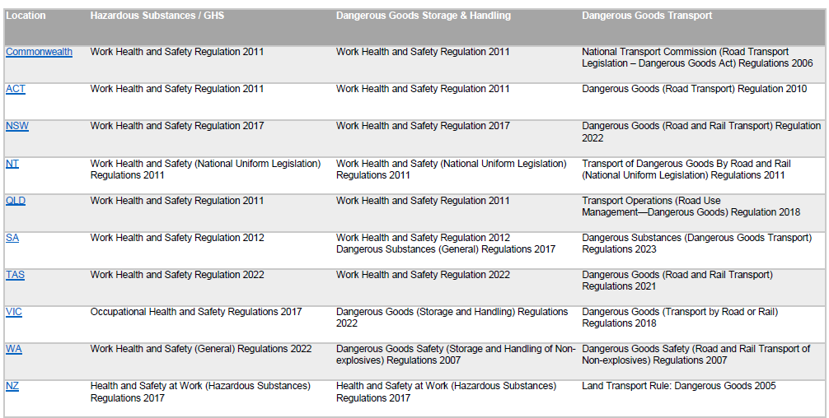
National Legislation Cross-Reference

Slide 32
Hazardous Substances

Slide 33
Classification of Hazardous Substances
A substance is deemed to be hazardous if it meets criteria specified in:
Globally Harmonised System of Classification and Labelling of Chemicals 7th Revised Edition (GHS)
GHS 7th Edition replaced 3rd Edition from 01/01/2023. Refer to Safe Work Australia guidance:
  GHS 7 – transition (including 15-minute Youtube webinar)
  Changes to chemical classifications and labelling under GHS 7
  Note: UNECE now up to 10th Revised Edition (2023)
Notes:
33

Slide 34
Globally Harmonised System of classification and labelling of chemicals (GHS)
The GHS is an internationally recognised system for the classification of chemicals
    Developed by United Nations Economic Commission for Europe (UNECE)
    Derived from existing systems, e.g. USA, Canada, EU, UN Transport of Dangerous Goods (TDG), etc.
Provides a harmonised system of hazard communication through labels and safety data sheets
Notes:
34

Slide 35

GHS classifies chemicals according to:
Physical hazards
  9 classes, aligned to the dangerous goods classes
  Environmental hazards
  Acute aquatic toxicity
  Chronic aquatic toxicity
  Health hazards
  Acute toxicity
  Skin corrosion
  Skin irritation
Health hazards (cont.)
  Serious eye damage
  Eye irritation
  Respiratory sensitizer
  Skin sensitizer
  Germ cell mutagenicity
  Carcinogenicity
  Reproductive toxicity
  Specific target organ toxicity (STOT)
  Aspiration hazard

Slide 36
Identifying hazards of chemicals
Section 2 of the SDS
Identifies hazardous substance chemical by:
  Pictograms (similar to DG diamonds)
  Signal Word – “WARNING” or “DANGER”
  Hazard and Precaution statements
  Hazard Category
Notes:
36

Slide 37
GHS Pictograms
The GHS prescribes 9 pictograms to convey the hazards of chemicals
Two new symbols introduced
All relevant pictograms appear on label (according to the prioritisation rules).
  In practice more than 4 pictograms is very rare
Notes:
The pictograms are the same shape as the Dangerous Goods labels (a square set at a point) and most, except the exclamation mark and the “health hazard symbol”, will be familiar. These are new symbols under the GHS to help convey health hazards that were not covered by the Dangerous Goods Code.
The border is red on a white background. If the product is for the domestic market only and is not for export, then the border can be black.
Each pictogram has an official name. The “health hazard” pictogram is colloquially known as “Star Man”, “Exploding torso” and others.
Priority rules: Rules for prioritising pictograms to preserve space on label and to prevent possible contradiction of information.
If skull and crossbones appears, exclamation mark will not appear.
If corrosive appears, exclamation mark will not appear for skin or eye irritation.
If health hazard appears for respiratory sensitisation, exclamation mark will not appear for skin sensitisation or skin or eye irritation.
If a transport pictogram appears, the equivalent GHS pictogram will not appear.

Slide 38














GHS Pictograms
The GHS also allows dangerous goods class labels to be displayed on labelling and safety data sheets.
There are no equivalents to the “exclamation mark” and “health hazard” pictograms.
1
2
3
4
5
6
8
9
Dangerous Goods Class
Notes:
Manufacturers and importer can continue to use the dangerous goods diamonds on labels if they wish.
Of course, depending on transport requirements it may be mandatory to have the dangerous goods pictogram on the container.
Note there is no dangerous goods equivalent of the exclamation mark and the health hazards symbols.
Note that DG class 7 (radioactive) is not covered by GHS. Neither is 6.2 (infectious substances).

Slide 39

GHS Pictogram for Flammable chemicals
6 different “flammable” symbols become one – intrinsic hazard not always obvious at a glance.
  Read label e.g. In contact with water releases flammable gas
  NO CHANGE TO PLACARDS - DG symbol still required
Notes:
Although the workplace label may change, the placard symbol will not. Therefore, in emergency situations, fire crews and response personnel will still have the information to deal with the situation.
Manufacturers can choose to put the dangerous goods symbol on labelling.

Slide 40
Hazard & Precaution Statements
  H followed by 3 numbers
  Physical hazards
  H225 Highly flammable liquid and vapour
  Health Hazards
  H302: Harmful if swallowed
  H350: May cause cancer
  Enviro hazards
  H410: Very toxic to aquatic life with long-lasting effects
  Country-specific (Australia)
  AUH014: Reacts violently with water
  P followed by 3 numbers
  General
    P102: Keep out of reach of children
  Prevention
    P233: Keep container tightly closed
  Response
    P372: Explosion risk in case of fire
  Storage
    P420: Store away from other materials
  Disposal
    P501: Dispose of contents/container to …

Slide 41
Hazard Category
Indicates level and type of Hazard
      Category 1 is most hazardous
      Category 4 is lowest
      Compare to Dangerous Goods Packing Group
      PG I, II or III (most to least dangerous)
    Example – BP Unleaded Petrol
      FLAMMABLE LIQUIDS - Category 1
      SKIN CORROSION/IRRITATION - Category 2
      GERM CELL MUTAGENICITY - Category 1B
      CARCINOGENICITY - Category 1B
      SPECIFIC TARGET ORGAN TOXICITY - SINGLE EXPOSURE (Narcotic effects) - Category 3
      ASPIRATION HAZARD - Category 1

Slide 42
Changes from HSNO to GHS 7 – New Zealand
On 30 April 2025, 4-year transition from NZ’s Hazardous Substances & New Organisms (HSNO) classification system to GHS 7 came to an end.
All substances must now comply with updated labelling, safety data sheets and packaging notices.
See : New Zealand’s hazard classification system (EPA NZ)
  HSNO to GHS7 Correlation table (PDF, 241KB)

Slide 43
Safety Data Sheets (SDS)
A Safety Data Sheet (SDS) is a technical bulletin containing detailed information about a hazardous substance.
  Formerly known as a Material Safety Data Sheet (MSDS)
An SDS must comply with VIC OHS Regulation 145
  WHS Regulations Part 7.1 Division 2
  NZ HSW (Hazardous Substances) Regulation 2.11
The hazard identification for the substance must be determined in accordance with the GHS.

Slide 44
Safety Data Sheet (Cont.)
Is an advisory document
Provides information on particular substances
However, producer of document picks up responsibility for:
  Completeness
  Accuracy
Duty of care

Slide 45
Safety Data Sheet (Cont.)
The manufacturer or importing supplier of a hazardous substance must ensure an SDS is prepared
Manufacturer or supplier must ensure a copy is provided
  on or before the first occasion that the substance is supplied to a person,
  after the SDS is reviewed
  to any employer who intends to use that hazardous substance in a workplace, on request.

Slide 46
Should a Safety Data Sheet be less than 5 years old?
YES!
VIC OHS Reg 146 Review and revision of safety data sheet
  A manufacturer or an importing supplier of a hazardous substance must ensure that the safety data sheet for a substance is reviewed—
  as often as is necessary to ensure that the safety data sheet contains current and accurate information; and
  at least every 5 years.
  AND
An employer must ensure that a current safety data sheet is available (Reg 155 and 156).
WHS Reg 330:
  (3) The manufacturer or importer of the hazardous chemical must:
  (a) review the safety data sheet at least once every 5 years…

Slide 47
16 Header SDS – Sections
Section 1 Identification of the material and supplier
Section 2 Hazards identification
Section 3 Composition/information on ingredients
Section 4 First aid measures
Section 5 Fire fighting measures

Slide 48
16 Header SDS – Sections (Cont.)
Section 6 Accidental release measures
Section 7 Handling and Storage
Section 8 Exposure Control / Personal Protection
Section 9 Physical and chemical properties
Section 10 Stability and reactivity

Slide 49
16 Header SDS – Sections (Cont.)
Section 11 Toxicological information
Section 12 Ecological information
Section 13 Disposal considerations
Section 14 Transport information
Section 15 Regulatory information
Section 16 Other information

Slide 50
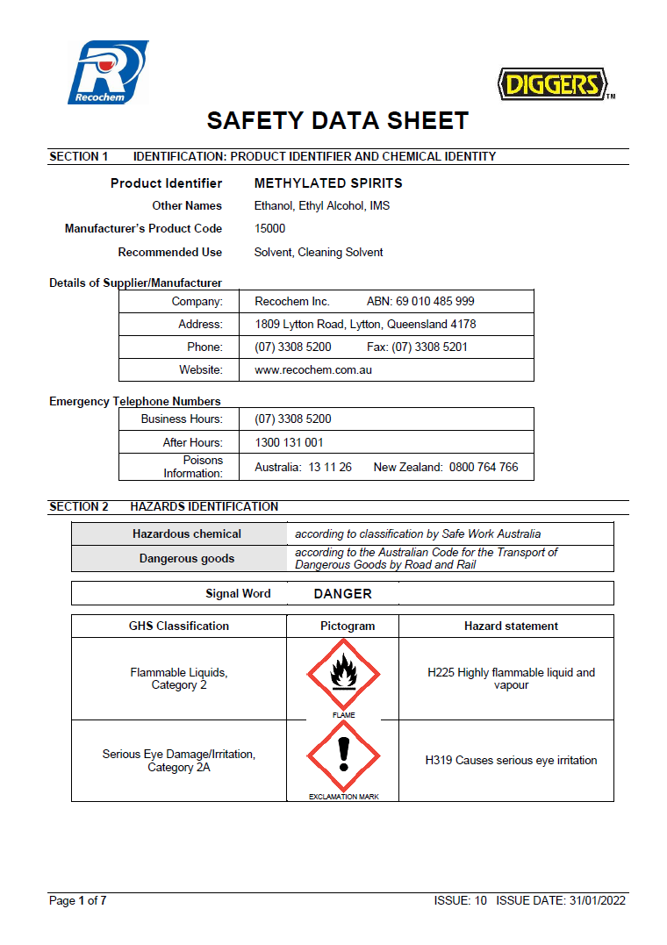
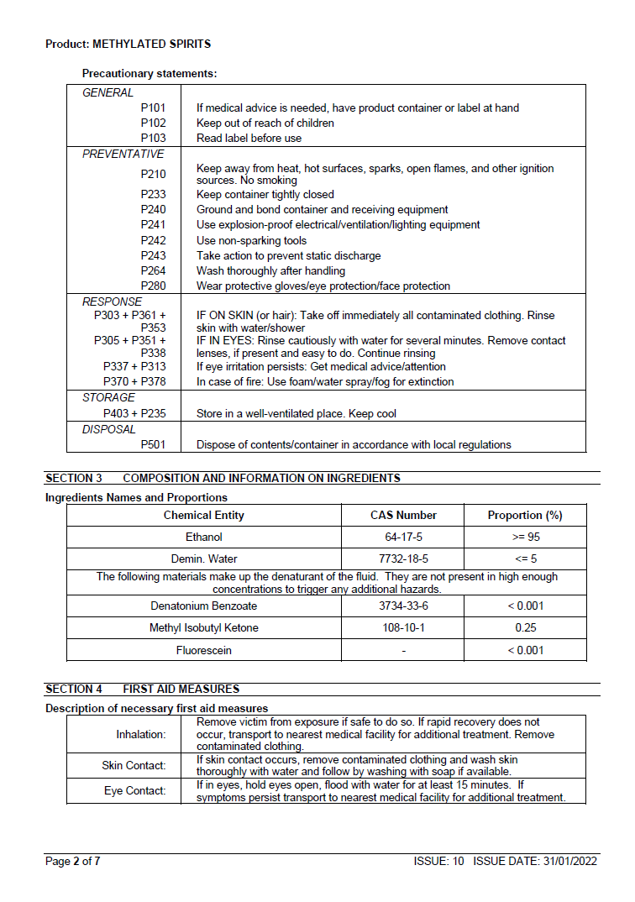

Slide 51
Safety Data Sheet Exercise
What is the issue date of the SDS?
What is the Product Name and name of the supplier?
  Section 1
Is the material Hazardous? If yes, write down one (1) Hazard Statement.
  Section 2
Is it a Dangerous Good? If so, what is the UN Number and Proper Shipping Name?
  Section 14
Which section describes physical and chemical properties of the material? Write down two (2) of its physical or chemical properties.

Slide 52
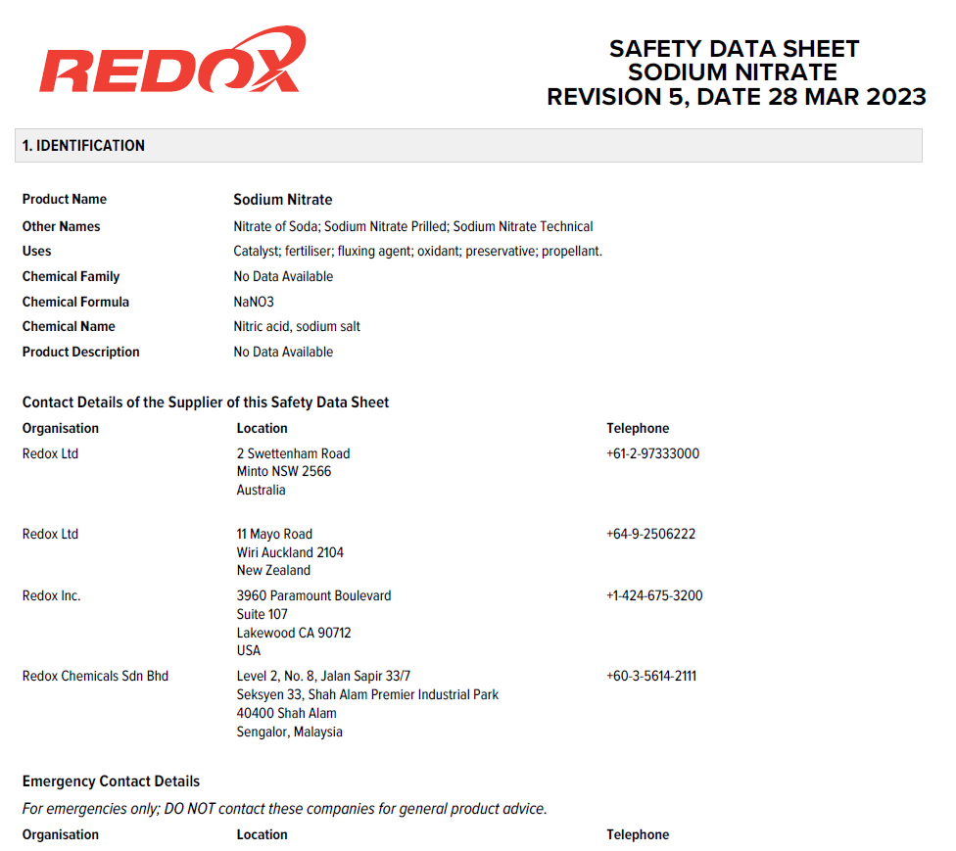
What is the issue date of the SDS?
What is the Product Name and name of the supplier?
  Section 1

Slide 53
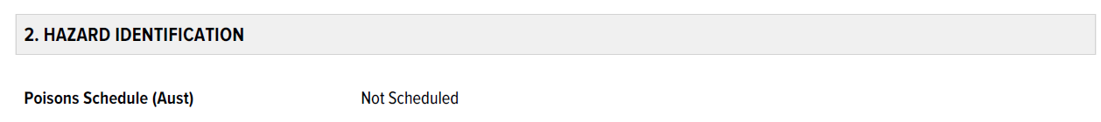
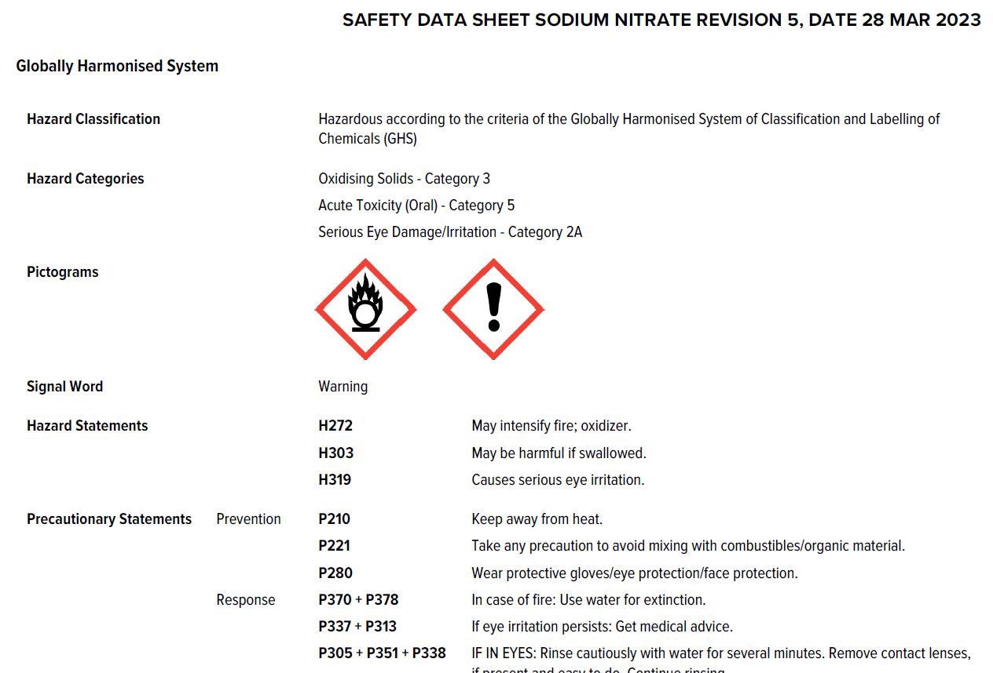
Is the material Hazardous? If yes, write down one (1) Hazard Statement.
  Section 2

Slide 54
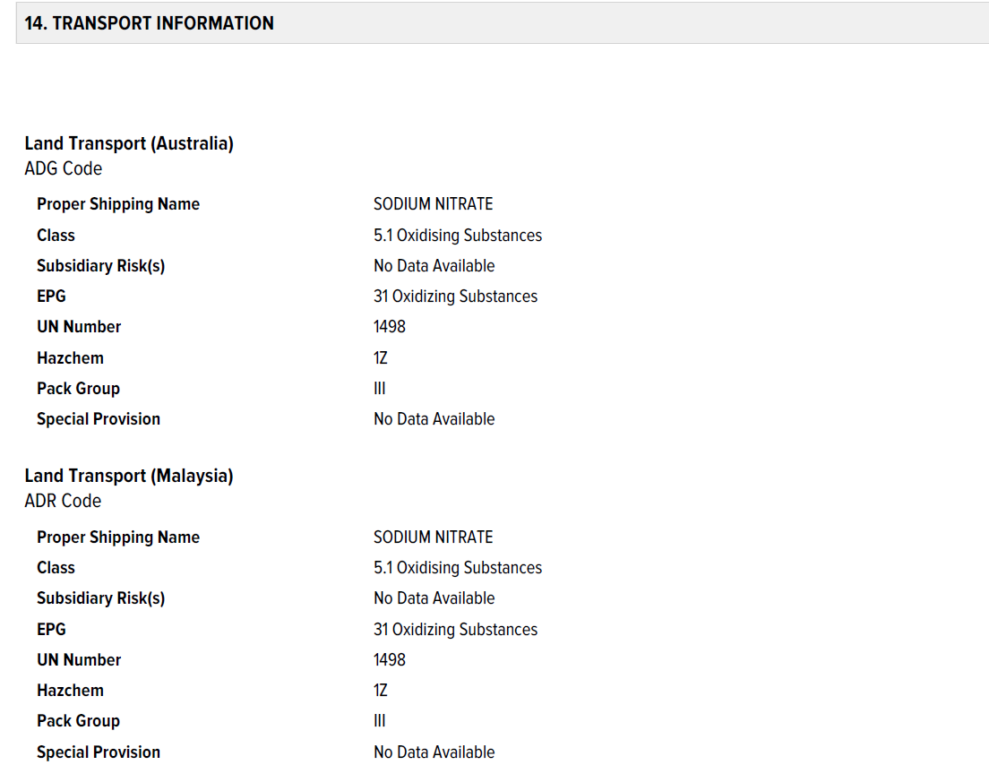
Is it a Dangerous Good? If so, what is the UN Number and Proper Shipping Name.
  Section 14

Slide 55
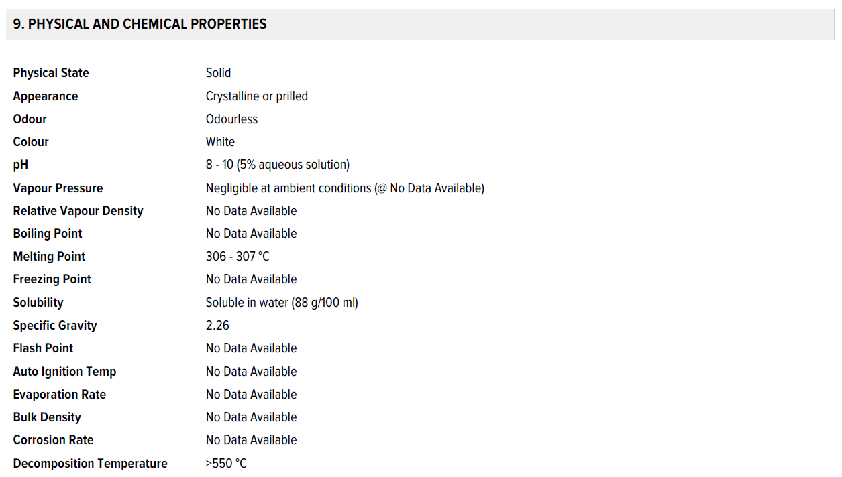
Which section describes physical and chemical properties of the material? Write down two (2) of its physical or chemical properties.

Slide 56
Safety Data Sheet Exercise
What is the issue date of the SDS?
  28 March 2023
What is the Product Name and name of the supplier?
  Redox Sodium Nitrate
Is the material Hazardous? If yes, write down one (1) Hazard Statement.
  Yes:
  H272 May intensify fire; oxidizer.
  H303 May be harmful if swallowed.
  H319 Causes serious eye irritation.

Slide 57
Safety Data Sheet Exercise
Is it a Dangerous Good? If so, what is the UN Number and Proper Shipping Name?
  UN Number 1498, Proper Shipping Name SODIUM NITRATE
Which section describes physical and chemical properties of the material? Write down two (2) of its physical or chemical properties.
  Physical State Solid, Appearance Crystalline or prilled, Odour Odourless, Colour White, pH 8 - 10 (5% aqueous solution), etc.

Slide 58
Hazardous Substances Register
Legal requirement
  VIC OHS Reg 162 and DG (S&H) Reg 58
  WHS Regulation 346
List of product names of all Hazardous Substances in the workplace, including Dangerous Goods and combustible liquids
Accompanied by the current SDS
Can (should!) be combined with Dangerous Goods Register

Slide 59
DG & Hazardous Substance Register
Supplier | Product | Issue Date | Expiry Date | Eye Hazard | Skin Hazard | Inhalation | Ingestion | DG Class
BOC Gases | Argoshield Light | 19/08/2021 | 19/08/2026 | No | No | No | No | 2.2 Non-Flammable Non-Toxic Gas
BOC Gases | Oxygen, Compressed | 19/08/2021 | 19/08/2026 | No | No | No | No | 2.2 Non-Flammable Non-Toxic Gas
bp | Automotive Diesel Fuel | 14/05/2021 | 13/05/2026 | Yes | Yes | Yes | Yes | Combustible Liquid
bp | Regular Unleaded Petrol | 26/05/2021 | 26/05/2026 | Yes | Yes | Yes | Yes | 3 Flammable Liquid
Castrol | Activ 2T | 24/03/2025 | 24/03/2030 | No | No | No | No | No
Cement Australia | Blended Cement | 24/03/2023 | 23/03/2028 | No | No | No | No | No
Recochem | Methylated Spirits | 31/01/2022 | 30/01/2027 | Yes | No | No | Yes | 3 Flammable Liquid
Redox | Sodium Nitrate | 28/03/2023 | 27/03/2028 | Yes | No | No | No | 5.1 Oxidiser

Slide 60
Dangerous Goods

Slide 61
Recap: Hazardous Substances vs. Dangerous Goods
Dangerous goods are classified based on immediate hazards during transport, storage and handling, e.g. explosion, fire, toxicity, corrosivity and radioactivity
Hazardous substances are classified based on the risks they pose to people during short and long-term exposure
While the categories overlap, they are not the same
The categories are not static – they are changing progressively, in Australia and internationally
Notes:
61
Example of a dangerous good.
Flammable Liquid
Explain what a flash point is and its impact on how dangerous a chemical will be
All dangerous goods have a un number. If they do not then they are not a dangerous good.

Slide 62
ADG Code
Australian Code for the Transport of Dangerous Goods by Road & Rail (ADG Code)
Maintained by the National Transport Commission (NTC).
Mainly intended for transport, but applies to manufacture and storage in relation to classification, labelling and packaging.

Slide 63
ADG Code (Cont…)
ADG7 replaced ADG6 in 2007, to align line with the UN Recommendations on the Transport of Dangerous Goods, 13th Edition (UN13).
ADG Code is reviewed 2-yearly based on UN Recommendations
  12-month overlap when adopted
Current version:
  ADG 7.8, based on UN22, adopted 1 April 2023, mandatory from 1 April 2024, can no longer be used from 1 October 2025.
  ADG 7.9, based on UN23, adopted as of 1 October 2024 , mandatory from 1 October 2025.

Slide 64
Structure of the ADG Code
The Code consists of:
  13 Parts
  4 Appendices
Notes:
64

Slide 65
Structure of the ADG Code (Cont…)
General Provisions, Definitions and Interpretation
Classification
Dangerous Goods Lists, Special Provisions and Limited Quantities Exceptions
Packing, Tank, Container, Vehicle and Equipment Provisions
Consignment Procedures – Including Labelling, Marking and Placarding
Requirements for the Construction and Testing of Packagings, IBCs, Large Packagings, Portable Tanks, MEGCs, Bulk Containers, Tank Vehicles, Freight Containers & Segregation Devices
Notes:
65

Slide 66
Structure of the ADG Code (Cont…)
Provisions Concerning Transport Operations
Stowage and Restraint
Segregation
Bulk Transfer of Dangerous Goods
Documentation
Safety Equipment for Road Vehicles
Procedures during Road Transport
Notes:
66

Slide 67
Structure of the ADG Code (Cont…)
Four Appendices:
Goods too dangerous to be transported
Forms
Hazchem codes
Code of practice for reprocessing steel drums
Notes:
67

Slide 68
Classification of Dangerous Goods
CLASS
  DIVISION
SUBSIDIARY HAZARD
PACKING GROUP
UN NUMBER
PROPER SHIPPING NAME
Notes:
UN number is a number designated by the UN for each chemical
This UN number can also be used where there are formulations and these form part of the groups that have NOS on the end of them
NOS meaning ..........
Proper Shipping Name is the UN designated name for the product and it is the name in the product list which is in capitals
Class has already been discussed.
Sub risk - In some cases a chemical can have one or more sub hazard as well as a major risk factor.
e.g. Draw on board.

Slide 69
DG Class, Division & Subsidiary Hazard
CLASS means the Class of Dangerous Goods as shown in the ADG Code
Within the Classes, there are DIVISIONS
Substances can be classified within 2 or more Classes, with secondary Class(es) referred to as SUBSIDIARY HAZARDS
Notes:
Show the students the class chart on the wall and explain to
them the changes in some of the class descriptions e.g. poison
Show the video on classes

Slide 70

Class 1: Explosives
Some Explosive Articles
Ammunition | Flash Powder | Smokeless Powder | Sounding Devices
Black Powder | Fuse | Primer | Torpedoes
Bombs | Fuse (Ammo) | Projectiles | Warheads
Charges | Igniters | Propellants
Fireworks | Mines | Rocket Motors
Flares | Powder cake | Signals

Slide 71
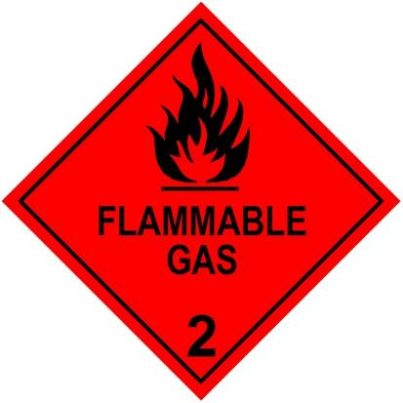
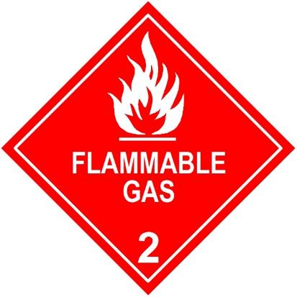
Division 2.1 Flammable Gases
Gases which ignite on contact with a source of ignition, however:
They only ignite in a certain range of concentrations with air
Above the upper limit – too rich to burn
Below the lower limit – too lean to burn
Heavier-than-air gas leaks may flow and accumulate in low points
  e.g. propane, butane (LPG)
Notes:
71

Slide 72

Aerosols

Slide 73
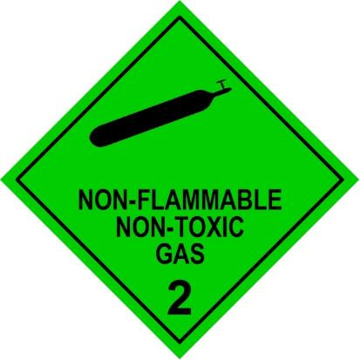
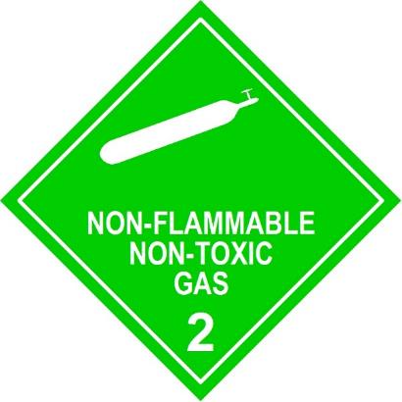
Division 2.2 Non-Flammable
Non-Toxic Gases
Not Flammable when exposed to a source of ignition
Not Toxic, but can cause death by asphyxiation
Most are heavier than air, many 6 or 7 times heavier
Some are stored in cryogenic form, i.e. below minus 150^{O}C
Notes:
73

Slide 74
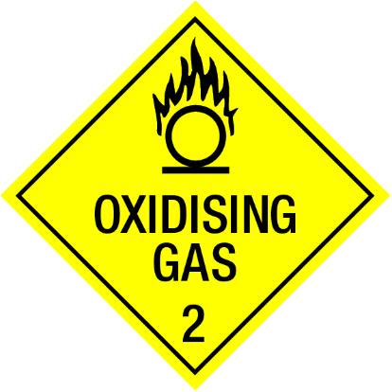
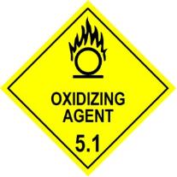
Oxidising Gases
Division 2.2 Non-Flammable Non-Toxic Gas with sub-hazard 5.1 Oxidiser
Examples:
  Oxygen gas
  Nitrous oxide
Oxidising Gas diamond can be used for road and rail transport in Australia
  It is not used internationally and cannot be used for sea freight (IMDG)
  Alternative is to use class 2.2 and sub-hazard 5.1 diamonds

Slide 75

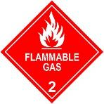
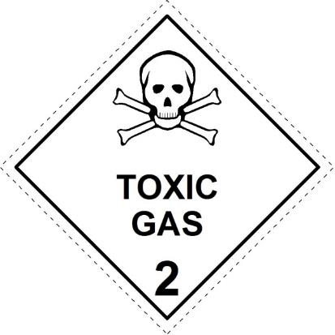
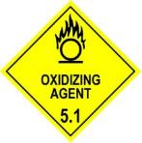
Division 2.3 – Toxic Gas
Most toxic gases are heavier than air and many have a subsidiary hazard
Ammonia, Anhydrous Sub-Hazard 8
Arsine SH 2.1
Bromine Chloride SH 5.1 & 8
Chlorine SH 5.1 & 8
Notes:
75

Slide 76
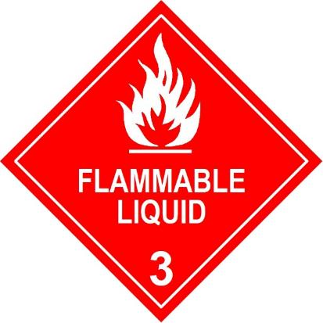
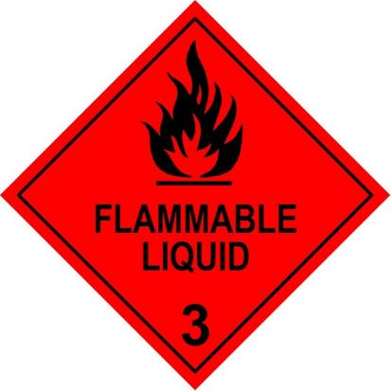
Class 3: Flammable Liquids
The UN defines a flammable liquid as:
  Any liquid having a flash point not more than 60º C
A C1 combustible liquid has a flash point above 60º C and below 93º C
Notes:
76

Slide 77
Class 4: Flammable Solids
Class 4 includes 3 Divisions with different diamonds:
4.1 Flammable solids
4.2 Spontaneously combustible
4.3 Dangerous when wet
Notes:
77

Slide 78
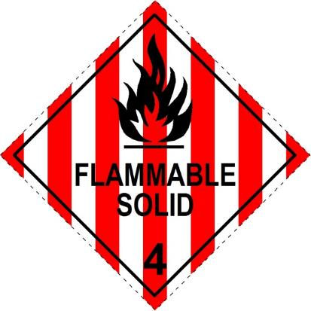

Division 4.1 Flammable Solids
Can be easily ignited by flames, sparks etc and are readily combustible
Danger may also come from toxic combustion products
Examples: sulphur
red phosphorus
  magnesium
  matches
  firelighters
Notes:
78

Slide 79
Division 4.1 Flammable Solids
Includes
  Readily Combustible Solids
  Desensitized Explosives
  Self-Reactive Materials
    Classified into Types A, B, C, D, E, F and G
Notes:
79

Slide 80
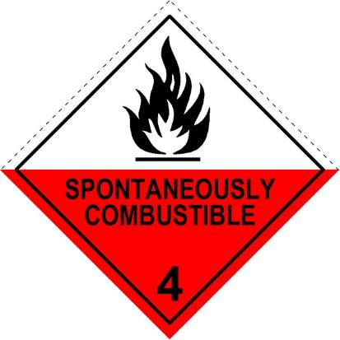
Division 4.2 - Spontaneously
Combustible
Can burst into flames without an external source of ignition being applied
Two types:
Pyrophoric materials
Self-heating materials
Examples:
White phosphorous (kept under water)
Activated carbon
Iron swarf
Notes:
80
The UN defines a spontaneously combustible material as either of the following:
A pyrophoric material is a liquid or solid that even in small quantities and without external ignition source can ignite within five minutes after coming in contact with air.
A self-heating material is a material that when in contact with air and without an energy supply is liable to self heat.

Slide 81
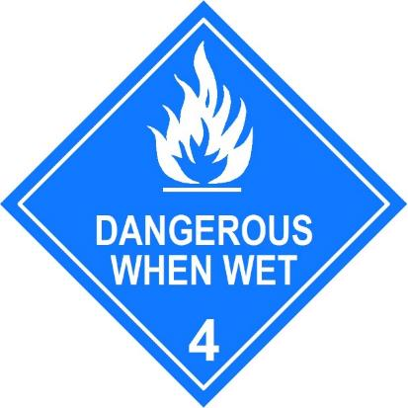
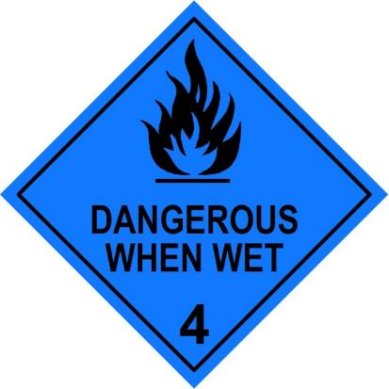
Division 4.3 - Substances which in contact with water emit flammable gases
When they react with water, these substances are liable to become spontaneously flammable due to the heat liberated by the reaction.
Examples:
sodium (gives off hydrogen)
calcium carbide (gives off acetylene)
Notes:
81

Slide 82
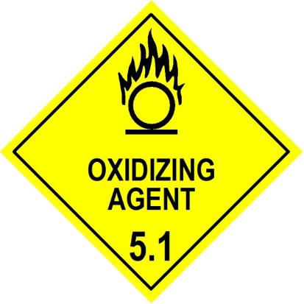
Division 5.1 – Oxidizing Agents
Not necessarily combustible but can liberate oxygen and therefore increase ferocity of a fire
Examples:
Sodium Nitrate
Hydrogen Peroxide
Notes:
82

Slide 83
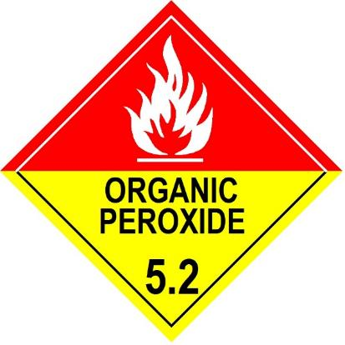
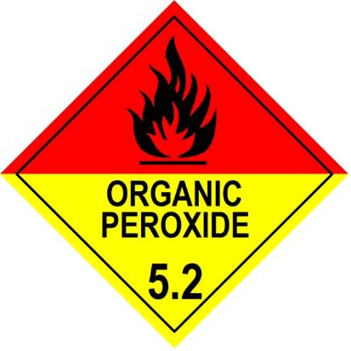
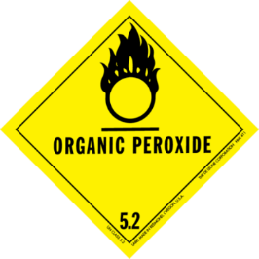
Division 5.2 – Organic Peroxides
Can react with organic materials to cause fire
Example:
  Epoxy adhesive hardener, MEKP (Methyl Ethyl Ketone Peroxide)
This DG Class Diamond is no longer used (discontinued as of 2011)
Notes:
83

Slide 84
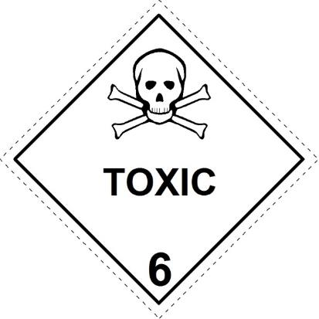
Division 6.1 - Toxic Substances
Liable to cause death or serious injury or be harmful to health if swallowed, inhaled or by skin contact
Examples:
Sodium cyanide
N,N-dimethylaniline
Alkaloids, solid, N.O.S.
Trichlorethylene
Methylene chloride
Notes:
84
The UN defines Toxic Substance 6.1 as follows:
A toxic material is a material (other than a gas) that is known to be toxic to humans, or
Is presumed to be toxic because of data obtained from tests performed on animals, or
Is an irritating material with properties similar to tear gas and causes extreme irritation, especially within confined spaces.

Slide 85

Division 6.2 Infectious Substances
An infectious substance is a viable microorganism or its toxin that causes or can cause disease in humans or animals.
Potentially infectious substances include:
Blood and blood products
Skin, tissue, cell cultures
Pathogens
  (viruses, bacteria, parasites, etc.)
  This placard is used for transport and on containers, but is not required for storage areas.
Notes:
85

Slide 86

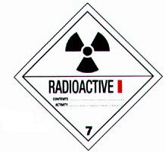
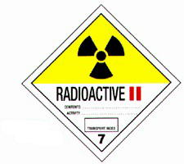
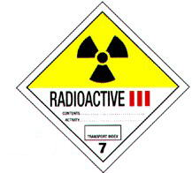

Class 7: Radioactive Materials
Radioactive White-I, Yellow-II, and Yellow-III alerts emergency response workers to increasing radioactivity.
White-I is the least radioactive and Yellow-III is the most radioactive.
Notes:
86
A radioactive material is any material or any combination of materials that spontaneously emits ionizing radiation having a specific activity greater than 70 Becquerels per gram.
Measured with a Geiger Counter.
Radioactive White-I, Yellow-II, and Yellow-III alerts emergency response workers to increasing radioactivity.
White-I is the least radioactive and Yellow-III is the most radioactive.

Slide 87
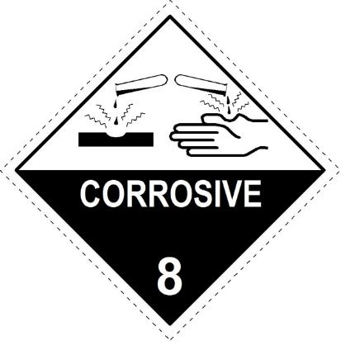
Class 8 - Corrosives
A corrosive material is either of the following:
Liquid or solid that causes visible destruction or irreversible alterations in skin tissue at the site of contact.
Liquid that has a severe corrosion rate on steel or aluminum, as measured in accordance with certain prescribed UN testing procedures.
Examples:
Solids sodium hydroxide pellets
Liquids hydrochloric acid
Some gases have sub-hazard 8 Corrosive
Notes:
87

Slide 88
Class 8 - Corrosives
Most corrosives are either Acidic or Alkaline
Acids – pH LESS THAN 7
      Strong acids – pH 0-2
      e.g. Hydrochloric acid, Sulphuric acid
Alkalis – pH GREATER THAN 7
    Strong alkalis – pH 12-14
    e.g. Sodium hydroxide, Potassium hydroxide
Class 8 Acids and Alkalis must be segregated
  Check pH in the SDS: SECTION 9 PHYSICAL AND CHEMICAL PROPERTIES
Notes:
88

Slide 89


Class 9: Miscellaneous Hazardous Materials
Materials that present a hazard during transportation but not included in any other hazard class.
Examples
  materials with anaesthetic or noxious properties
  elevated-temperature substances – e.g. hot bitumen
  hazardous wastes
  marine pollutants
  magnetized materials,
  lithium and sodium batteries (risk of fire if damaged)
Notes:
89

Slide 90

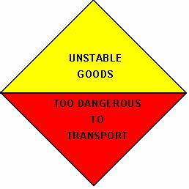

Other Dangerous Goods Diamonds
Multi Class diamond – used for transport
Goods too dangerous to be transported
Environmentally Hazardous mark

Slide 91
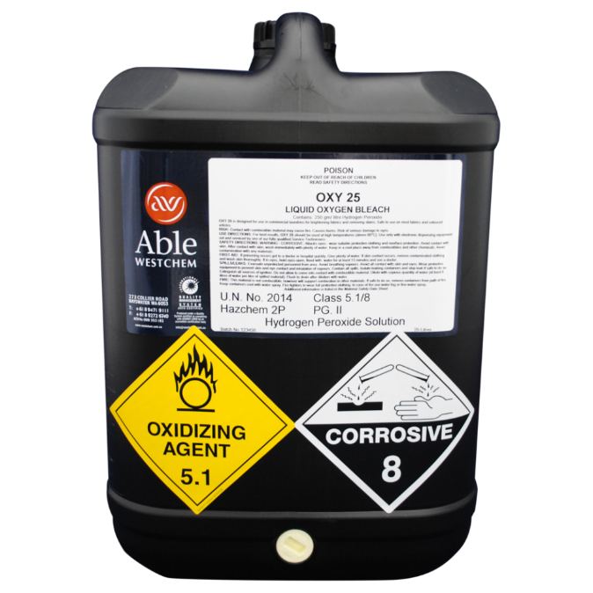
Subsidiary Hazard
A secondary hazard (or risk) that meets the UN criteria
e.g. Hydrogen peroxide
  Class 5.1
  Subsidiary hazard 8

Slide 92
Packing Group
Packing Group I
  Great Danger
Packing Group II
  Medium Danger
Packing Group III
  Minor Danger
Used for packing purposes, to classify common DGs
NOT used for explosives, gases, radioactives, organic peroxides, infectious substances and some class 4 substances

Slide 93
DG Packing Group vs. GHS Category
GHS refers to “Categories” which are aligned to DG Packing Groups
  e.g. DG Class 3 Flammable Liquids
DG PG | GHS Category | Criteria | Hazard Statement
I | 1 | Flash point < 23°C and initial boiling point ≤ 35°C | H224 Extremely flammable liquid and vapour
II | 2 | Flash point < 23°C and initial boiling point >35°C | H225 Highly flammable liquid and vapour
III | 3 | Flash point ≥ 23°C and ≤ 60°C | H226 Flammable liquid and vapour
 | 4 | Flash point > 60°C and ≤ 93°C | H227 Combustible liquid

Slide 94
UN Number
Internationally recognized 4-digit number – mainly used in transport.
Maybe specific to a chemical, or generic to a class – e.g.
  UN 1114 BENZENE
  UN 1950 AEROSOLS
  UN 2921 CORROSIVE SOLID, FLAMMABLE, N.O.S. (Not Otherwise Specified)
  UN 3480 LITHIUM ION BATTERIES (including lithium ion polymer batteries)

Slide 95
Proper Shipping Name
  2790 ACETIC ACID SOLUTION more than 10% but not less than 80% acid by mass
The proper shipping name is the part of the description shown in UPPER CASE

Slide 96
Special Classifications
Materials transported at or above their flash point are classified as flammable liquids
  UN 3256 ELEVATED TEMPERATURE LIQUID, FLAMMABLE, N.O.S.
    Example is hot bitumen
Liquids transported above 100ºC, and solids transported above 240ºC are Class 9
  UN 3257 ELEVATED TEMPERATURE LIQUID, N.O.S.
  UN 3258 ELEVATED TEMPERATURE SOLID, N.O.S.

Slide 97



ELEVATED TEMPERATURE
LIQUID FLAMMABLE
UN No.
3256
HAZCHEM
2Y
IN EMERGENCY, DIAL
000, POLICE OR FIRE BRIGADE
SPECIALIST ADVICE
131 700

Slide 98
Fire Risk Dangerous Goods
Goods which burn readily or support combustion
Classes 2.1, 3, 4 or 5, or products with
a 2.1, 3, 4 or 5 sub-hazard

Slide 99
Packaging
Dangerous Goods for transport must be in approved packaging.
  Prescribed packaging (e.g. Gas cylinders)
  Packaging that has a requirement to pass a testing standard (e.g. Steel drum)
Notes:
ONE SHOULD ALWAYS PACK GOODS EVEN IF THEY ARE FOR STORAGE ONLY IN SAFE WELL MARKED PACKAGING.

Slide 100
Prescribed Packaging
Particular forms of packaging are prescribed for some classes of Dangerous Goods
Class 2 Gases
Division 4.1 Self-reactive substances only
Division 5.2 Organic Peroxides

Slide 101

Approved Package Marking

Slide 102




Other Information
ADG includes a large amount of specific detail about packaging and transport – e.g.

Slide 103
Other requirements

Slide 104
AICIS
Companies importing or manufacturing industrial chemicals into Australia need to register with AICIS (Australian Industrial Chemicals Introduction Scheme)
  Formerly NICNAS (National Industrial Chemicals Notification and Assessment Scheme)
All imported or manufactured chemicals must be listed on the Australian Inventory of Industrial Chemicals (AICS)
  Most substances are already listed.
New (unlisted) substances must be categorised as:
  Listed introduction,
  Exempted introduction,
  Reported introduction,
  Assessed introduction, or
  Commercial evaluation.
    See: https://www.industrialchemicals.gov.au/

Slide 105
SUSMP (Poisons Schedule)
Standard for the Uniform Scheduling of Medicines and Poisons
Schedule | Description
Schedule 2. | Pharmacy Medicine
Schedule 3. | Pharmacist Only Medicine
Schedule 4. | Prescription Only Medicine, or Prescription Animal Remedy
Schedule 5. | Caution
Schedule 6. | Poison
Schedule 7. | Dangerous Poison
Schedule 8. | Controlled Drug
Schedule 9. | Prohibited Substance
Schedule 10 | Substances of such danger to health as to warrant prohibition of sale, supply and use
A Health Department Poisons License may be required to manufacture, store, supply or use certain Schedule 7 poisons

Slide 106


APVMA
Australian Pesticides and Veterinary Medicines Authority (APVMA) has a separate registration process and separate labelling requirements
  The labelling requirement is unrelated to GHS or DG.
Before an agricultural or veterinary chemical product can be legally supplied, sold, or used in Australia it must be registered by APVMA, and display an approved label.
    See https://www.apvma.gov.au/registrations-and-permits/apvma-labelling-codes
Specific training is available for users (“ChemCERT” / Agricultural Chemical User Permit, ACUP)

Slide 107
URL - additional information
Australian Dangerous Goods Code (ADG )
  http://www.ntc.gov.au/heavy-vehicles/safety/australian-dangerous-goods-code/
Safe Work Australia
  www.safeworkaustralia.gov.au
National Transport Commission – ADG Code
  https://www.ntc.gov.au/codes-and-guidelines/australian-dangerous-goods-code
UN Model Regulations for the Transport of Dangerous Goods
  https://unece.org/info/publications/pub/364867
Global Harmonisation System (GHS) – UNECE
  https://www.unece.org/trans/danger/publi/ghs/ghs_welcome_e.html
Labelling of Agricultural and Veterinary chemicals
  https://apvma.gov.au/registrations-and-permits/labelling-codes
Poisons Schedule (SUSMP)
  https://www.tga.gov.au/publication/poisons-standard-susmp
Notes:
107

Slide 108
URL - additional information
EPA NZ – Hazardous substances classification
  https://www.epa.govt.nz/industry-areas/hazardous-substances/new-zealands-new-hazard-classification-system/
WorkSafe New Zealand – Hazardous Substances
  https://www.worksafe.govt.nz/topic-and-industry/hazardous-substances/
Hazardous Substances Toolbox
  https://www.hazardoussubstances.govt.nz/
NZ Land Transport Agency
  https://nzta.govt.nz/resources/rules/dangerous-goods-2005-index/
NZ Health and Safety at Work (Hazardous Substances) Regulations
  https://www.legislation.govt.nz/
Notes:
108

Slide 109
Australian & New Zealand Standards
  AS 1940–2017 The storage and handling of flammable and combustible liquids
  AS 2243.2:2021 Safety in laboratories Chemical aspects and storage
  AS 3780–2023 The storage and handling of corrosive substances
  AS/NZS 3833:2007 The storage and handling of mixed classes of dangerous goods, in packages and intermediate bulk containers
  AS 4332–2004 (R2016) The storage and handling of gases in cylinders
  AS/NZS 4452:1997 The storage and handling of toxic substances
  AS/NZS 4681:2000 The storage and handling of Class 9 (miscellaneous) dangerous goods and articles
  AS/NZS 5026:2012 The storage and handling of Class 4 dangerous goods
  NZS 5433:2020 Transport of dangerous goods on land
  SNZ HB 5433:2021 UN dangerous goods list

Slide 110
Sources of information
Physical inspection
Internal and external audits
Employee knowledge and expertise
Trade journals
WorkCover alerts and publications
Incident /injury records
Industry associations
Notes:
110

Slide 111
Sources of information (Cont…)
Product information
Technical data sheets
Manufacturers instruction manuals
Personal contacts
By asking ‘What if?’
Brainstorming
Notes:
111

Slide 112
AEBN SERIES 1: Dangerous Goods, Hazardous Substances and GHS Workshop Webinar
17 September 2025
Presented by
Australian Environment Business Network (AEBN)
National Office
100 Douglas Pde Williamstown Vic 3016 (PO Box 588 Altona Vic 3018)
T +61 3 9397 2511 | E aebn@aebn.com.au www.aebn.com.au

