Slide 1





aebn webinar 2025 aebn national conference on environment, climate change and energy new laws, developments and funding for business in 2025 7 march 2025 - 10.00am – 4.00pm (aedt)
Presented by the Australian Environment Business Network (AEBN)
In association with our Principal Partners
PRINCIPAL PARTNERS

Slide 2
2025 aebn national conference on environment, climate change and energy webinar – 7 March 2025 welcome and introduction tina khoury Chief Executive Australian Environment Business Network (AEBN)
Presented by the Australian Environment Business Network (AEBN)
In association with our Principal Partners
PRINCIPAL PARTNERS

Slide 3
2025 aebn national conference on environment, climate change and energy webinar – 7 March 2025 webinar guidance and welcome Lelanie smuts facilitator Australian Environment Business Network (AEBN)
Presented by the Australian Environment Business Network (AEBN)
In association with our Principal Partners
PRINCIPAL PARTNERS

Slide 4


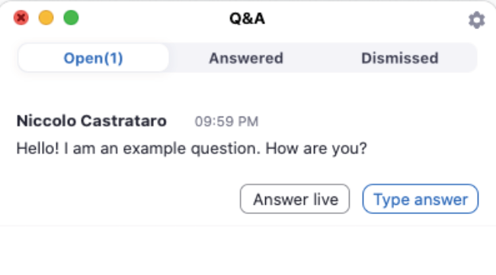

Zoom tips for Delegates
Double click your screen for Full Screen Mode.
Speaker mode will show presentation in full screen.
Questions: To ask a question, please click Q&A (located on the toolbar on the bottom of your screen).

Slide 5
2025 aebn national conference on environment, climate change and energy webinar – 7 March 2025 New mandatory climate-related financial disclosure laws | update on esg regulations in Australia and abroad | turning your climate and net zero strategy into transition plan Victoria cross Partner, Corporate Sustainability and Climate Change erm
Presented by the Australian Environment Business Network (AEBN)
In association with our Principal Partners
PRINCIPAL PARTNERS

Slide 6
2025 aebn national conference on environment, climate change and energy webinar – 7 March 2025 issues arising in 2025: safeguard mechanism updates and deadlines | Market interactions/accu scheme | emerging markets | the new guarantee of origin legislation and responsibilities of businesses jane wardlaw general manager, national greenhouse and energy reporting & safeguard branch clean energy regulator
Presented by the Australian Environment Business Network (AEBN)
In association with our Principal Partners
PRINCIPAL PARTNERS

Slide 7

Climate policies in 2025
Jane Wardlaw
General Manager
Scheme Operations Division
March 2025

Slide 8
Overview
1 Safeguard update
Market interactions/ACCU Scheme
Emerging markets
Questions

Slide 9
Safeguard Mechanism update
1

Slide 10
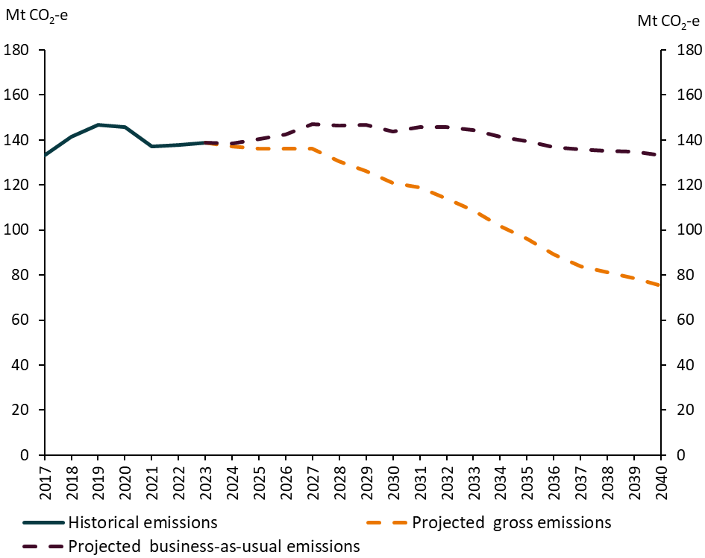
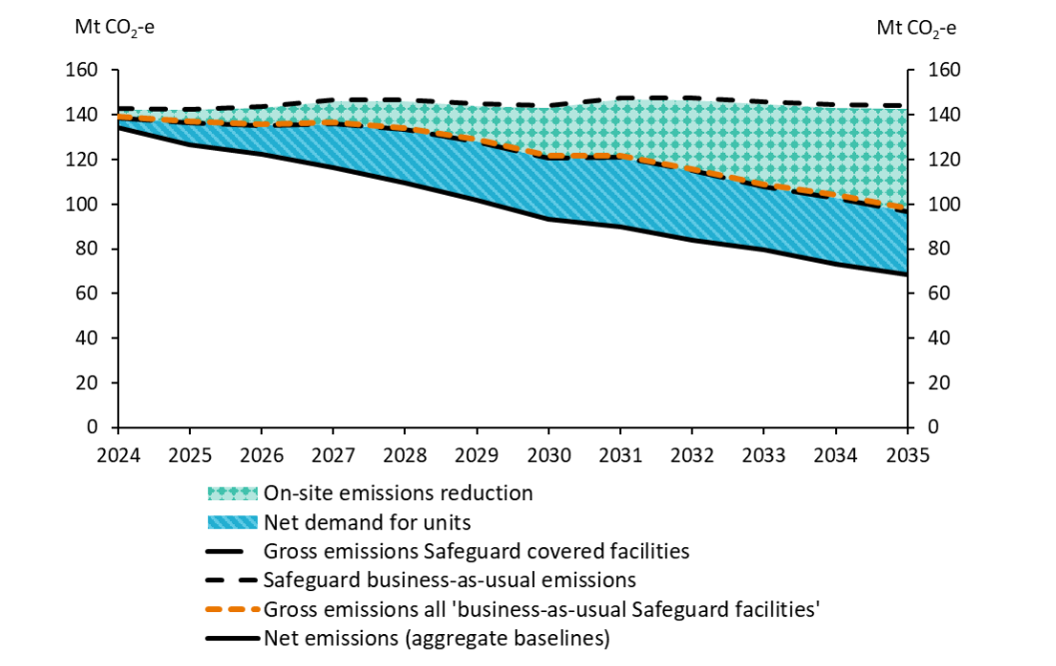
Australia’s commitment to the 2030 43% emissions reduction is a legislated international commitment
Sources: DCCEEW

Slide 11
Key dates under the reformed Safeguard Mechanism
Complete by | Activity
31 October 2024 | ​Deadline to submit 2023-24 National Greenhouse and Energy Reporting (NGER) reports, including 2023-24 Safeguard production data. Deadline to submit 2023-24 Trade-exposed baseline assessment (TEBA) applications. Deadline to submit 2023-24 exemption applications.
15 November 2024 | Deadline to submit 2023-24 multi-year monitoring period (MYMP) applications.
30 January 2025 | Latest date for Safeguard Mechanism credit (SMC) applications, to be issued SMCs as close to 31 January 2025 as is reasonably practicable.
28 February 2025 | Deadline to submit 2023-24 borrowing applications.
31 March 2025 | Deadline to surrender ACCUs or SMCs to avoid excess emissions by 1 April 2025.
15 April 2025 | Deadline for the CER to publish 2023-24 Safeguard data.
You are here
Source: Key dates for responsible emitters | Clean Energy Regulator

Slide 12




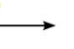
Surrender ACCUs and SMCs
✔
Responsible emitter submits form in Online Services
CER initiates transactions in ANREU
Authorised representatives complete surrender
Position statement updated in Online Services

Slide 13
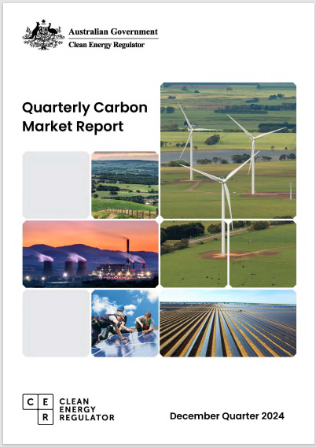
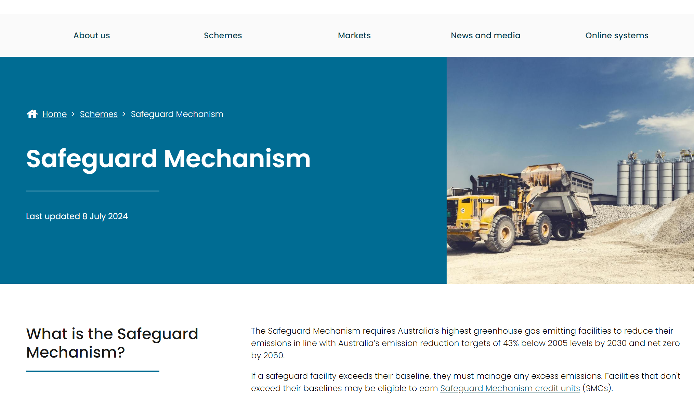
Communication, engagement and transparency are key aspects of implementation
Transparency is key
Annual publication of Safeguard data:
facility-level compliance outcomes
aggregate scheme performance
Compliance and enforcement priority
focus on accuracy of data and management of excess emissions

Slide 14
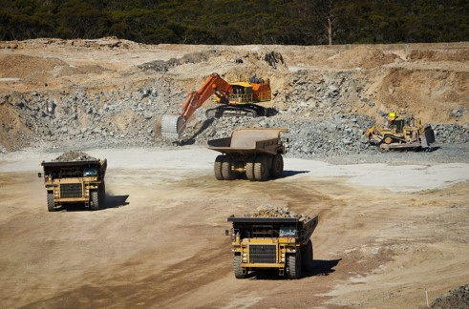
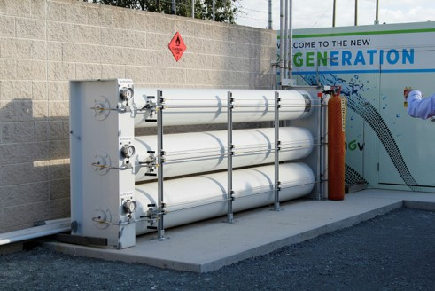
Emissions reduction will be key to meeting Safeguard obligations
Emissions reduction is a key strategic issue.
Business improvements and efficiencies are a critical starting point but will not to be enough in the longer term.
Early action on transformational emissions reductions strategies is equally important.

Slide 15
Market Interactions/ACCU Scheme
2

Slide 16
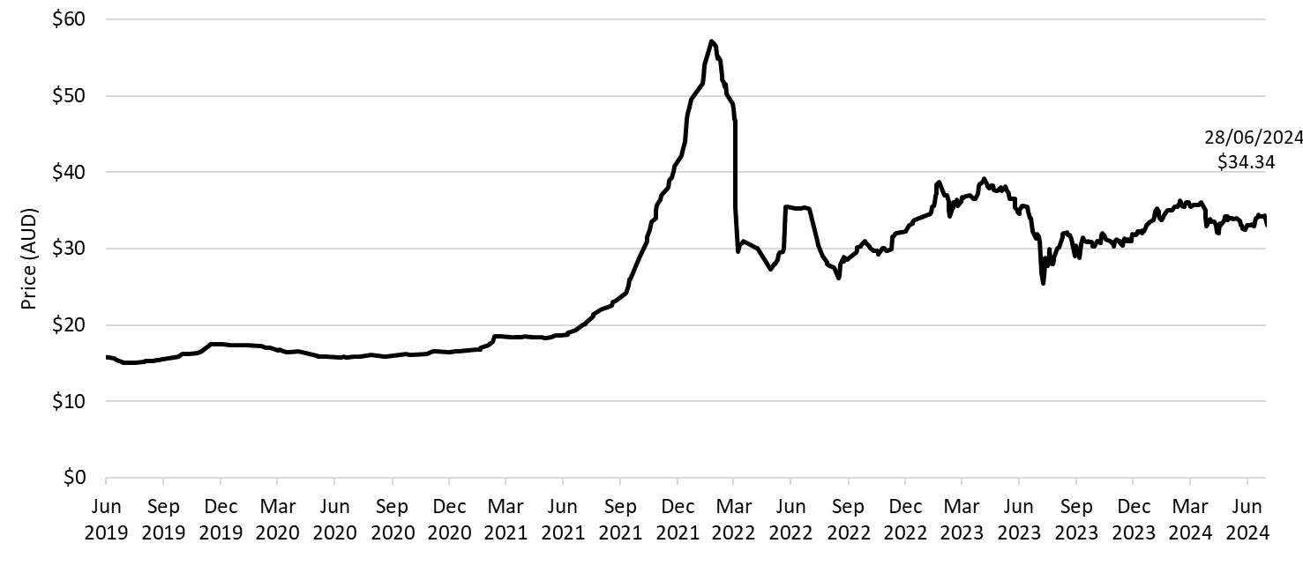
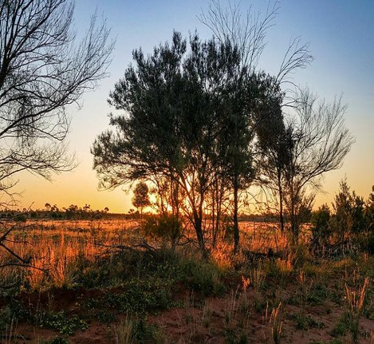
Safeguard facilities will play a pivotal role in the integrity of the ACCU Scheme

Slide 17
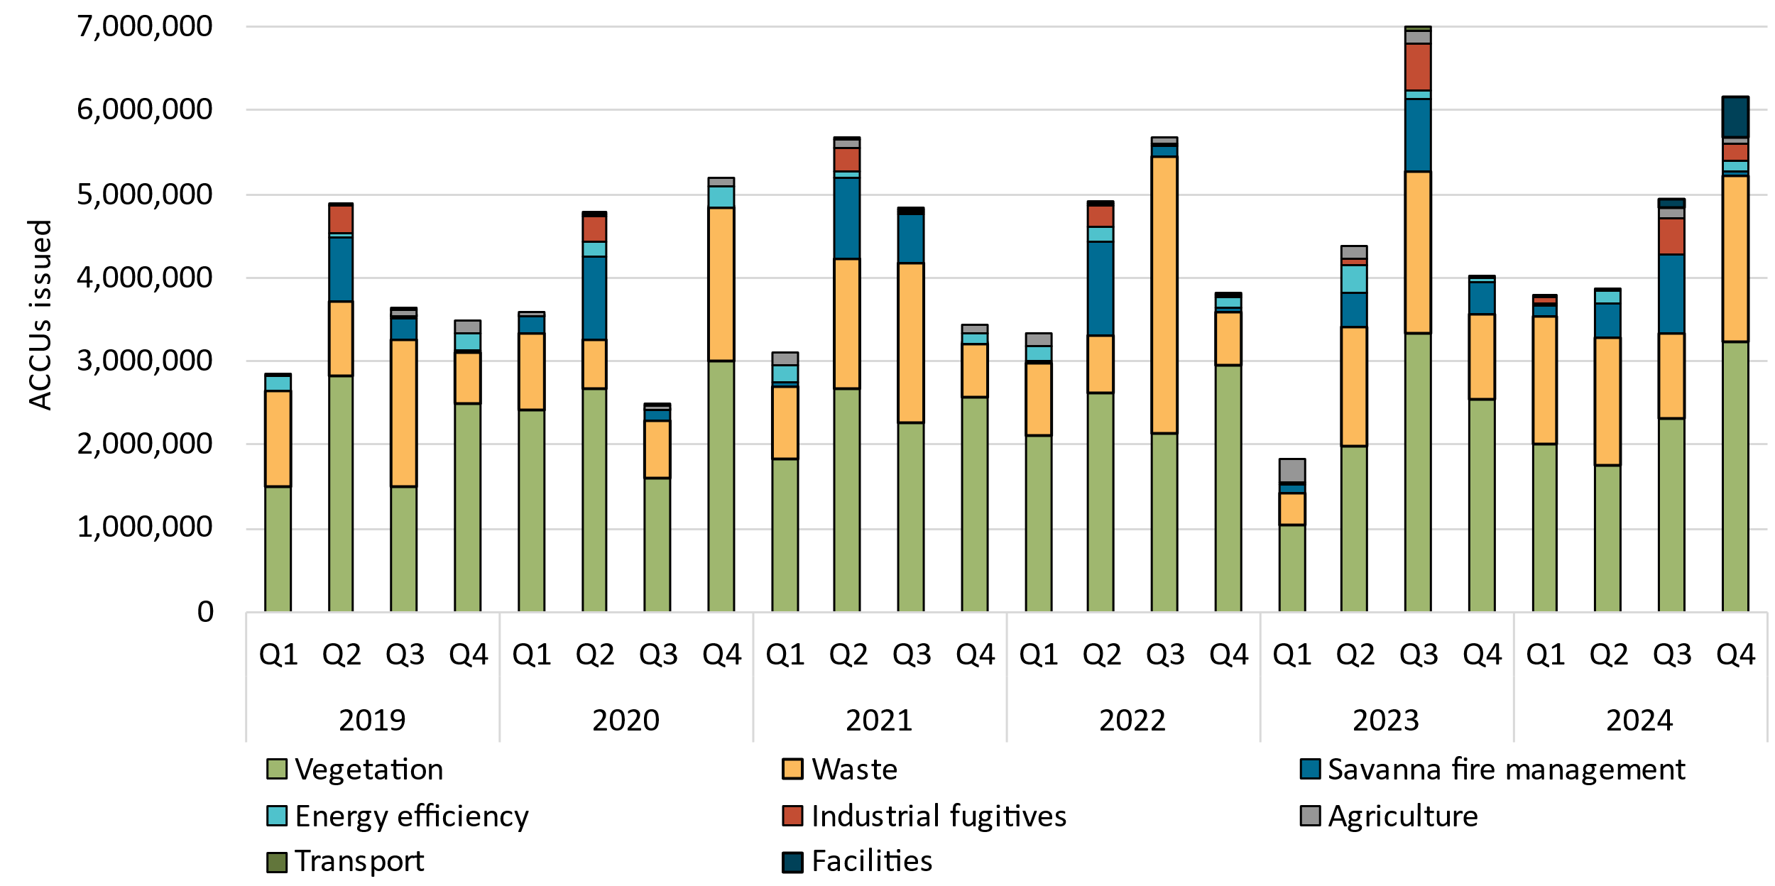
Record ACCU issuance in 2024

Slide 18
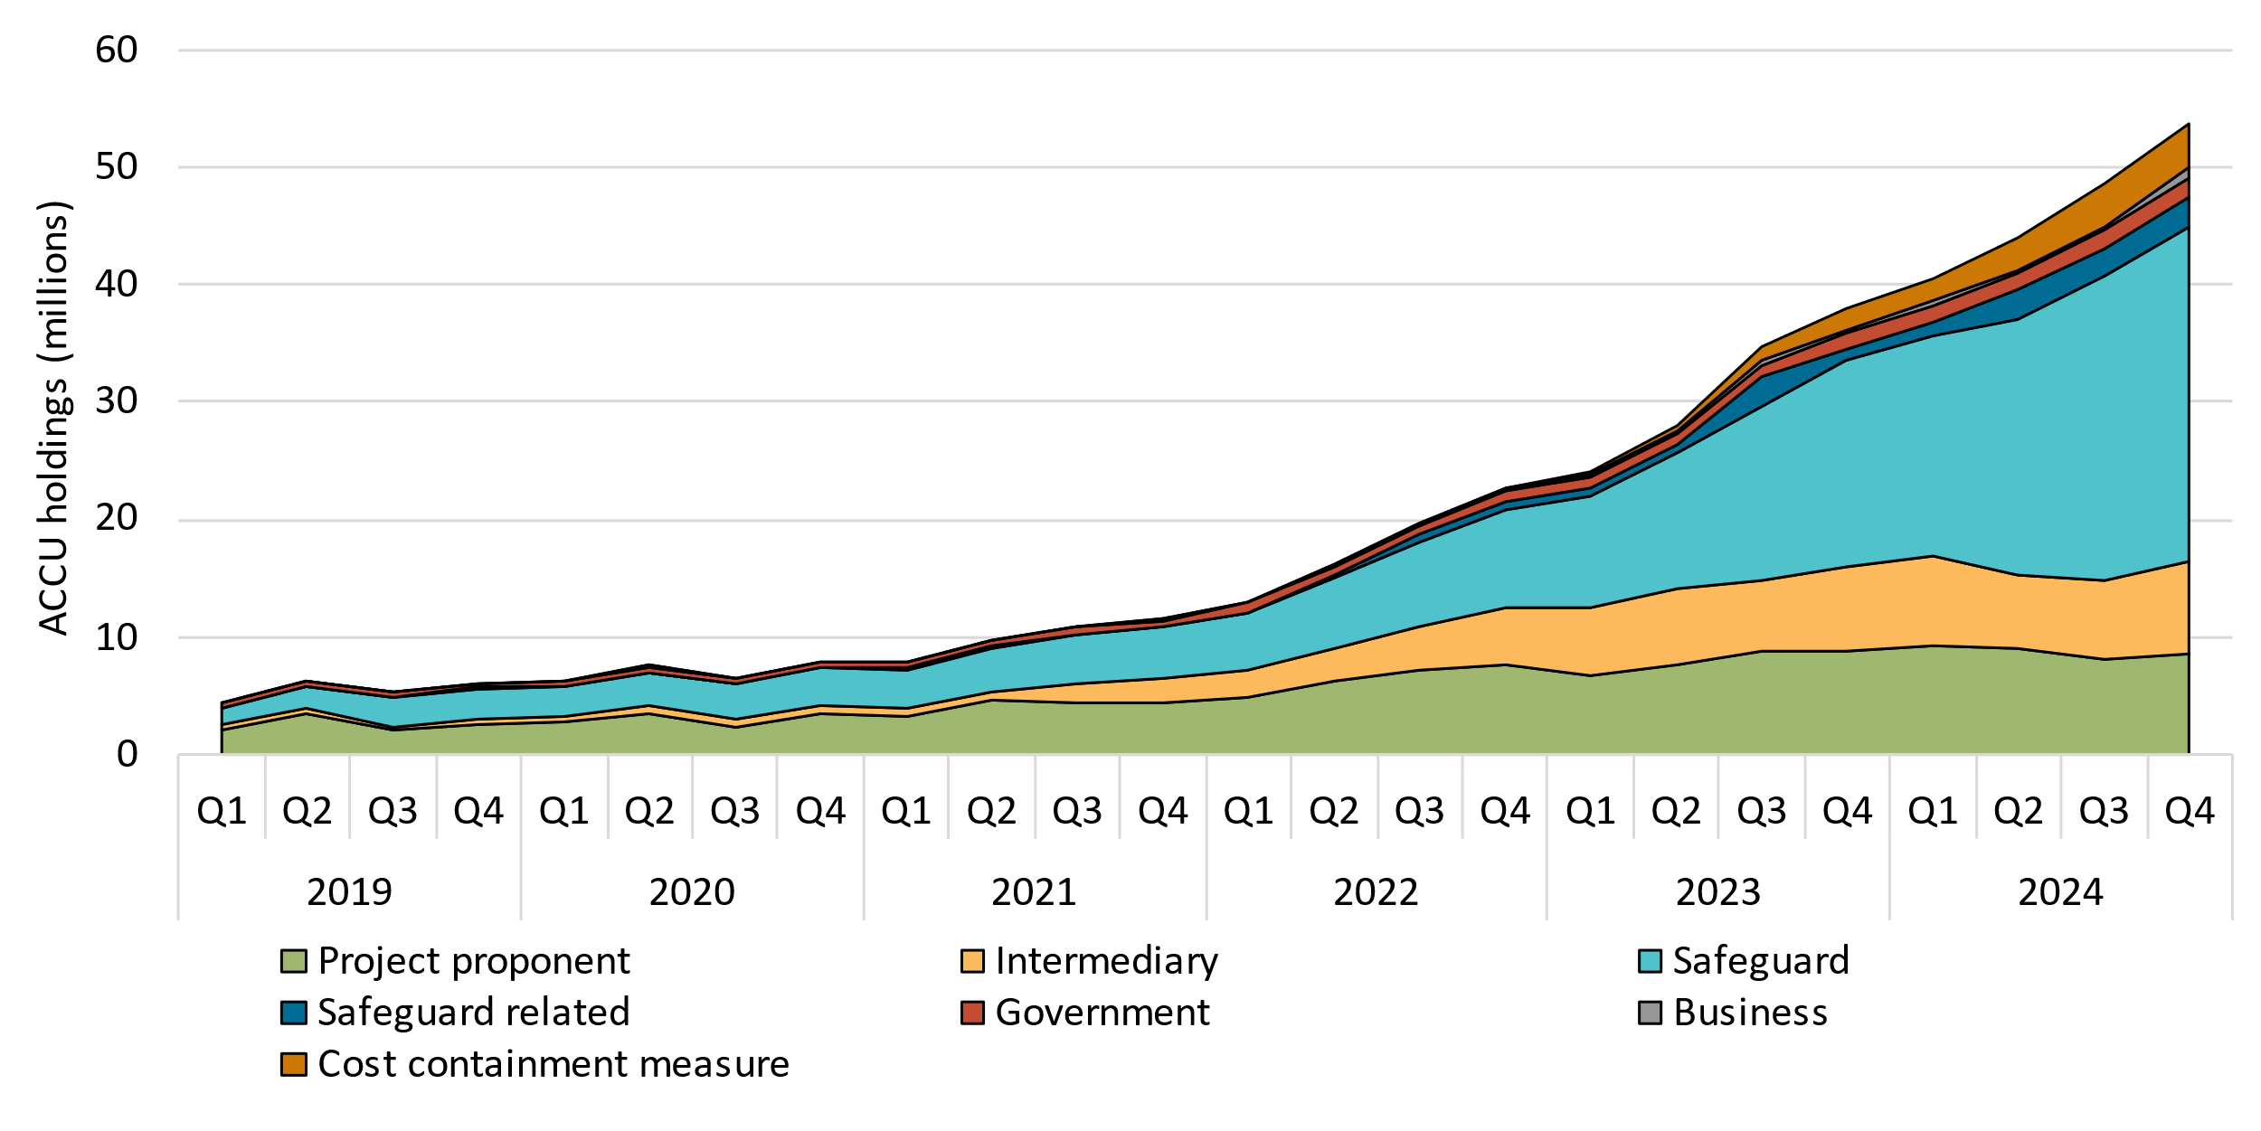
ACCU holdings increased to 49.9 million at the end of Q4 2024

Slide 19
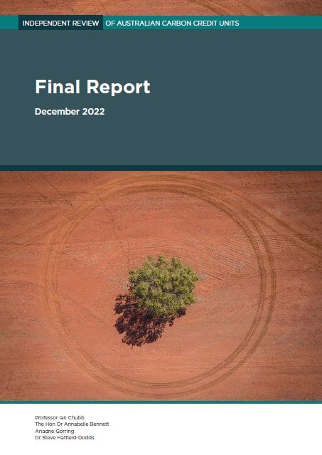
You can have confidence in the integrity of ACCUs
ACCU Review (Dec ‘22)
ACCU Scheme arrangements are sound.
Climate Change Authority’s Review (Dec ‘23)
ACCU Scheme is fundamentally well designed.
ANAO Performance Audit Report (April ‘24)
The CER’s administration of the ACCU Scheme is effective and ANAO made no recommendations to CER.
Method-specific papers on risk management (Feb ‘25)
Human-induced regeneration method – managing project risk to deliver carbon abatement for Australia

Slide 20
Emerging markets
3

Slide 21
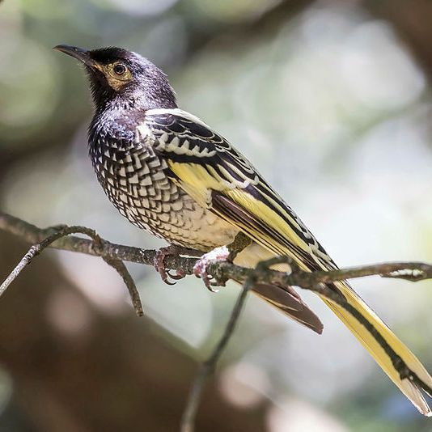
Nature Repair Market
Legislated, national, voluntary biodiversity market
Incentivises actions to restore and protect the environment
Encourages practices that deliver improved biodiversity outcomes
Establishes marketplace to undertake projects to generate tradable certificates

Slide 22

Guarantee of Origin
Establishes a national certification mechanism to track and verify emissions and renewable-electricity generation
Australian businesses will be able to create:
Product GO (PGO) certificates and
Renewable Electricity GO (REGO) certificates
Supports development of markets and international trade
Consultation on Exposure Draft of GO Rules open now: https://consult.dcceew.gov.au/tranche-1-exposure-draft-guarantee-of-origin-rules

Slide 23
Thank you

Slide 24
2025 aebn national conference on environment, climate change and energy webinar – 7 March 2025 TEA BREAK (PLEASE RETURN AT 11.55AM)
Presented by the Australian Environment Business Network (AEBN)
In association with our Principal Partners
PRINCIPAL PARTNERS

Slide 25
2025 aebn national conference on environment, climate change and energy webinar – 7 March 2025 renewable energy for corporates: NAVIGATING THE RENEWABLE ENERGY Transition: the CHALLENGES AND STRATEGIES FOR CORPORATES Gilles walgenwitz Partner and General Manager, Energy Markets ERM
Presented by the Australian Environment Business Network (AEBN)
In association with our Principal Partners
PRINCIPAL PARTNERS

Slide 26
2025 aebn national conference on environment, climate change and energy webinar – 7 March 2025 commonwealth, qld, wa, nt, tas – a legal perspective of the changes in 2025 including recent trends in prosecutions Gabrielle guthrie principal Guthrie legal
Presented by the Australian Environment Business Network (AEBN)
In association with our Principal Partners
PRINCIPAL PARTNERS

Slide 27
2025 aebn national conference on environment, climate change and energy webinar – 7 March 2025 lunch BREAK (PLEASE RETURN AT 1.40pm)
Presented by the Australian Environment Business Network (AEBN)
In association with our Principal Partners
PRINCIPAL PARTNERS

Slide 28
2025 aebn national conference on environment, climate change and energy webinar – 7 March 2025 Victoria – environmental compliance changes in 2025 | initiatives for businesses with operations in Victoria and EPA Victoria’s expectations of Victorian businesses LEE MIEZIS CHIEF EXECUTIVE OFFICER EPA VICTORIA
Presented by the Australian Environment Business Network (AEBN)
In association with our Principal Partners
PRINCIPAL PARTNERS

Slide 29
2025 aebn national conference on environment, climate change and energy webinar – 7 March 2025 Victoria – A LEGAL PERSPECTIVE ON ENVIRONMENTAL LAWS IN VICTORIA | TRENDS IN ENFORCEMENT IN VICTORIA… STEFAN FIEDLER PRINCIPAL RUSSELL KENNEDY LAWYERS
Presented by the Australian Environment Business Network (AEBN)
In association with our Principal Partners
PRINCIPAL PARTNERS

Slide 30
2025 aebn national conference on environment, climate change and energy webinar – 7 March 2025 NEW SOUTH WALES – NSW CLIMATE CHANGE POLICY AND CLIMATE CHANGE ACTION PLAN 2023-26 | PROTECTION OF THE ENVIRONMENT POLICY FOR Sustainable construction | climate change mitigation and adaptation plans and best practice guidance kay baxter manager policy – nsw epa
Presented by the Australian Environment Business Network (AEBN)
In association with our Principal Partners
PRINCIPAL PARTNERS

Slide 31
2025 aebn national conference on environment, climate change and energy webinar – 7 March 2025 tea BREAK (PLEASE RETURN AT 3.15pm)
Presented by the Australian Environment Business Network (AEBN)
In association with our Principal Partners
PRINCIPAL PARTNERS

Slide 32
2025 aebn national conference on environment, climate change and energy webinar – 7 March 2025 south Australia – environmental and climate change compliance changes for 2025 – what businesses need to know Kathryn bellette director policy assessment and finance, sa epa
Presented by the Australian Environment Business Network (AEBN)
In association with our Principal Partners
PRINCIPAL PARTNERS

Slide 33
2025 aebn national conference on environment, climate change and energy webinar – 7 March 2025 funding and grants from across Australia for businesses ANDREA YTUARTE ORANTES SENIOR CONSULTANT ANTHESIS
Presented by the Australian Environment Business Network (AEBN)
In association with our Principal Partners
PRINCIPAL PARTNERS

Slide 34
aebn webinar 2025 aebn national conference on environment, climate change and energy new laws, developments and funding for business in 2025 7 march 2025 - 10.00am – 4.00pm (aedt)
Presented by the Australian Environment Business Network (AEBN)
www.aebn.com.au
PRINCIPAL PARTNERS

