Slide 1









4. Division 4.3 | 3. General | 2. Foodstuffs | 1. Corrosive Acids
5. Corrosive alkalis | 6. Flammable Store | 7. Poisons Store | 8. Oxidisers
Emerg. Exit
Emerg. Exit
MONO SODIUM GLUTAMATE
(food grade)
(1 pallett – 1 tonne)
THIOUREA
(1 X 25 Kg Sack)
Passageway Exit
Deluge System
Firewall – floor to ceiling
OFFICE
FLAKE CAUSTIC SODA
1 Tonne (20 Kg bags)
UN No 1823
PG II
HYDROCHLORIC ACID
PG II : 8
1 x 40L Carboy
(50 Kg)
XXXX
FIRE HYDRANT
REEL & HOSE
FIRE HYDRANT
REEL & HOSE
DRY CHEM
FIRE EXT’S
FIRE HYDRANT
REEL & HOSE
FIRE HYDRANT
REEL & HOSE
FIRE HYDRANT
REEL & HOSE
BATTERY ACID
H₂SO₄
PG II : 8
1 x 200L Drum
(250 Kg)
SODIUM CYANIDE
PG I : 6.1 (a)
1 x 50 Kg Drum
Deluge System
Emerg. Exit
Emerg. Exit
Emerg. Exit
Gas cage
Gas cage
POLYMERIC BEADS EXPANDABLE
(1 pallett – 1 tonne)
UN No 2211
PG III
CARBON TETRACHLORIDE
PG II : 6.1 (a)
1 x 200L Drum
(240 Kg)
TOLUENE
PG II : 3.1
20 x 200L Drum
NITRO CELLULOSE LACQUER
PG III : 3.2
Pallet of 16 x 4L Cans (80 Kg)
CALCIUM HYPOCHLORITE
PG II : 5.1
1 x Pallet x 4 L Plastic Buckets (50 Kg)
CALCIUM CARBIDE
PG II : 4.3
250 Kg Drum
COMPRESSED OXYGEN
– : 2.2 : 5.1
1 x 10 Kg Cylinder
COMPRESSED AIR
– : 2.2
1 x 10 Kg Cylinder
ACETYLENE
– : 2.1
1 x Cylinder (35 Kg)
CALCIUM CARBONATE
(1 x 50 Kg Sack)

Slide 2


Slide 3
4. Division 4.3 | 3. General | 2. Foodstuffs | 1. Corrosive Acids
5. Corrosive alkalis | 6. Flammable Store | 7. Poisons Store | 8. Oxidisers
CALCIUM CARBIDE
PG II : 4.3
250 Kg Drum
Emerg. Exit
THIOUREA
(1 X 25 Kg Sack)
MONO SODIUM GLUTAMATE
(food grade)
(1 pallett – 1 tonne)
Emerg. Exit
BATTERY ACID
H₂SO₄
PG II : 8
1 x 200L Drum
(250 Kg)
POLYMERIC BEADS EXPANDABLE
(1 pallett – 1 tonne)
UN No 2211
PG III
HYDROCHLORIC ACID
PG II : 8
1 x 40L Carboy
(50 Kg)
Passageway Exit
Deluge System
Firewall – floor to ceiling
OFFICE
XXXX
FIRE HYDRANT
REEL & HOSE
FIRE HYDRANT
REEL & HOSE
DRY CHEM
FIRE EXT’S
FIRE HYDRANT
REEL & HOSE
FIRE HYDRANT
REEL & HOSE
FIRE HYDRANT
REEL & HOSE
CALCIUM CARBONATE
(1 x 50 Kg Sack)
FLAKE CAUSTIC SODA
1 Tonne (20 Kg bags)
UN No 1823
PG II
TOLUENE
PG II : 3.1
20 x 200L Drum
NITRO CELLULOSE LACQUER
PG III : 3.2
Pallet of 16 x 4L Cans (80 Kg)
SODIUM CYANIDE
PG I : 6.1 (a)
1 x 50 Kg Drum
CARBON TETRACHLORIDE
PG II : 6.1 (a)
1 x 200L Drum
(240 Kg)
CALCIUM HYPOCHLORITE
PG II : 5.1
1 x Pallet x 4 L Plastic Buckets (50 Kg)
Deluge System
Emerg. Exit
Emerg. Exit
Emerg. Exit
COMPRESSED OXYGEN
– : 2.2 : 5.1
1 x 10 Kg Cylinder
Gas cage
COMPRESSED AIR
– : 2.2
1 x 10 Kg Cylinder
Gas cage
ACETYLENE
– : 2.1
1 x Cylinder (35 Kg)

Slide 5

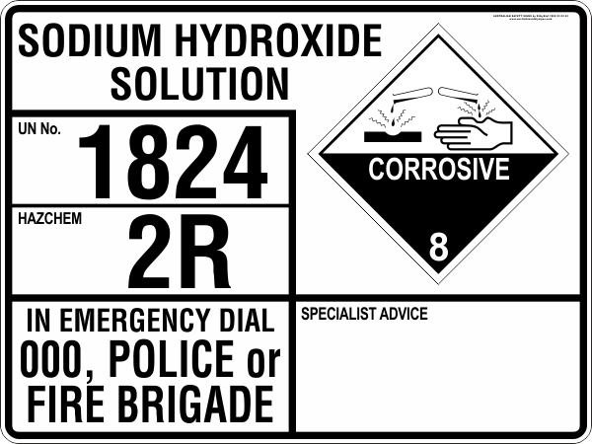
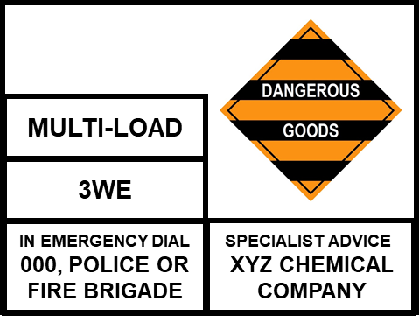
16 x 200L White Spirit
4 x 1000L Sodium Hydroxide 46%
3
3
3
3
8
8
3
3
3
3
3
3
3
3
8
8
3
3
3
3
TURPENTINE
SUBSTITUTE
TURPENTINE
SUBSTITUTE
UN No.
1300
UN No.
1300
HAZCHEM
3Y
HAZCHEM
3Y
XYZ CHEMICAL COMPANY
XYZ CHEMICAL COMPANY
IN EMERGENCY DIAL
000, POLICE or
FIRE BRIGADE
SPECIALIST ADVICE
IN EMERGENCY DIAL
000, POLICE or
FIRE BRIGADE
SPECIALIST ADVICE
ABC SOLVENT SUPPLIES
ABC SOLVENT SUPPLIES

Slide 7

XYZ CHEMICAL COMPANY
3
3
3
3
8
8
3
3
3
3
3
3
3
3
8
8
3
3
3
3
XYZ CHEMICAL COMPANY

