Slide 1

Webinar Housekeeping – please read!
As this is a webinar we ask all participants to please note the following:
MOBILE PHONES are to be either switched off or switched to silent
SPEAKER VIEW: if you could please switch your screen to SPEAKER VIEW. To do this, take your mouse and hover over your screen and to the top RIGHT corner of your screen please click SPEAKER VIEW.
MORNING TEA: Morning Tea will be at 11.30am for 20 min
The Webinar will conclude at 1.30pm and will follow with Q&A for 15 minutes for those participants that have further queries of our presenter
QUESTIONS: This is an interactive Webinar and you are encouraged to please ask any questions that you may have of our presenter, Ross. To ask a Question, please hover over your screen with your mouse and click on the UNMUTE button. Once you have asked your question, please click MUTE – to avoid any background noise from entering the Webinar. You may also hold down your space bar to ask your question and release it after you have asked your question. Ross and the AEBN team will be here to assist you.
THANK YOU!

Slide 2
AEBN SERIES 2: Dangerous Goods and Hazardous Substances Workshop Webinar
5 April 2023
Presented by
Australian Environment Business Network (AEBN) www.aebn.com.au

Slide 3


Zoom Tips!
Double click your screen for Full Screen Mode.
When in Full Screen Mode, hover over the top of the participants bar to change your view of other participants.
To Ask Questions: When on mute, hold down the SPACE BAR to temporarily unmute yourself.
Look at the bar at the bottom of your screen for additional options.
Full screen mode
Recommended speaker view

Slide 4

Agenda
Refresher – Intro to Dangerous Goods (DG)
Storage and Handling
Road and Rail Transport

Slide 5
Legislative Framework
MODEL ACT FOR THE TRANSPORT OF DANGEROUS GOODS BY ROAD AND RAIL 2007
MODEL SUBORDINATE LAW FOR THE TRANSPORT OF DANGEROUS GOODS BY ROAD AND RAIL
Australian Dangerous Goods Code (ADG7.7)
IMDG CODE (SEA TRANSPORT)
IATA REGULATIONS (AIR TRANSPORT)
Notes:
5
There are four key pieces of Legislation which cover the storage and handling and transport of dangerous goods.
These are ,
Storage and handling of dangerous goods
Australian code of transport of DG's by road and rail
IMDG code for transport by sea
IATA code for transport by air
There are others which we will discuss later

Slide 6
LEGISLATIVE FRAMEWORK
- VICTORIA
DANGEROUS GOODS ACT 1985
DANGEROUS GOODS (STORAGE AND HANDLING) REGULATIONS 2022
DANGEROUS GOODS (TRANSPORT BY ROAD OR RAIL) REGULATIONS 2018
Notes:
6
There are four key pieces of Legislation which cover the storage and handling and transport of dangerous goods.
These are ,
Storage and handling of dangerous goods
Australian code of transport of DG's by road and rail
IMDG code for transport by sea
IATA code for transport by air
There are others which we will discuss later

Slide 7
Hazardous Substances
Hazardous Chemicals regulated in nationally harmonised Work Health & Safety (WHS) laws:
  ACT, NSW, NT, QLD, SA, TAS, WA, Commonwealth
  In VIC, Hazardous Substances are regulated under existing OHS laws:
  WA has adopted modified WHS laws, but Dangerous Goods remain outside
National review of WHS laws in 2019
GHS edition 7 mandatory as of 1-Jan-2023 after 2-year transition (replacing edition 3)

Slide 8
Safe Work Australia
  Australian Government statutory body –
Responsibility for improving work health and safety and workers’ compensation arrangements across Australia
Safe Work Australia is not a regulator, no regulatory powers

Slide 9
Transport of Dangerous Goods
Not covered by the Work Health & Safety (WHS) regulations for hazardous chemicals
These remain covered by transport laws and the Australian Dangerous Goods (ADG) Code, as implemented in each state.
  Administered by National Transport Commission (NTC)

Slide 10
Hazardous Substances
Hazardous substances (VIC) are those that, following worker exposure, can have an adverse effect on health.
  Examples include poisons, substances that cause burns or skin and eye irritation, and substances that may cause cancer.
  Many hazardous substances are also classified as dangerous goods.
  In other states, WHS Regulations refer to Hazardous Chemicals instead of Hazardous Substances
Notes:
10

Slide 11
Safety Data Sheet (SDS)
A Safety Data Sheet (SDS) is a technical bulletin containing detailed information about a hazardous substance.
  Formerly known as a Material Safety Data Sheet (MSDS)
An SDS must comply with VIC OHS Regulation 145
  WHS Regulations Part 7.1 Division 2
The hazard identification for the substance must be determined in accordance with the GHS.

Slide 12
GHS
Globally Harmonised System of Classification and Labelling of Chemicals (GHS)
Internationally recognised system for the classification of chemicals
Developed by a United Nations (UN) committee

Slide 13
Australian Dangerous Goods Code Edition 7.7 (ADG7.7)
ADG7 replaced ADG6 from 2007
  ADG7.7 adopted from 1 October 2020, mandatory from 1 October 2021
  Based on UN21
  ADG 7.8, based on UN22, adopted for use from 1 April 2023.
  Mandatory from 1 October 2023.

Slide 14
Objectives
To be able to identify and be aware of the hazards of Dangerous Goods
To make the Storage and Handling of Dangerous Goods safer

Slide 15


Changes in ADG7.5
New lithium battery mark
“Retail Distribution Load” replaced by “Concessional Limited Quantities”

Slide 16
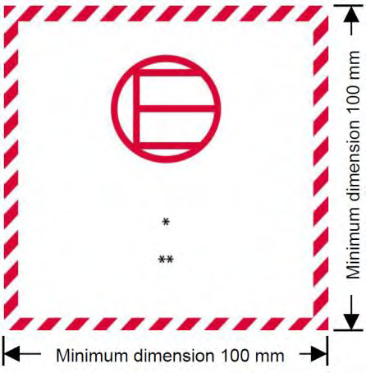
Changes in ADG7.6
  “Subsidiary Hazard” replaced the term Subsidiary Risk
  Minor classification changes
  New UN Numbers
  Inclusion of “Excepted Quantities” (column 7b) in Table 3.2.3 Dangerous Goods List

Slide 17
Changes in ADG7.7
Simplified Limited Quantity requirements
Amended special provisions and packing instructions for automotive battery transport

Slide 18
Changes in ADG7.8
Not as significant as previous versions
Updated table of exempted consignments to the UN Model Regulations and the ADG Code.
  Exempts very small quantities of DGs from the code’s provisions.
  Aligns with limited quantity concessions for dangerous goods and Lithium batteries.
Other provisions affecting containers and packaging.

Slide 19
Dangerous Goods in the Workplace
Under VIC DG (Storage & Handling) Regulations
Equivalent obligations in:
  WHS Regulations (all states except VIC & WA): Schedule 11 hazardous chemicals
  WA Dangerous Goods Safety (Storage and Handling of Non-explosives) Regulations

Slide 20
Duties of manufacturers and suppliers
Determine if goods are dangerous goods
Classify the dangerous goods
Prepare SDS
Provide SDS
Correctly package, mark and label the dangerous goods
Notes:
20

Slide 21
Duties of Occupier (or PCBU)
Consultation
Induction & training
Obtain SDSs
DG Register
Safety signage / placarding
Packaging & marking
Hazard identification & risk control
Stability
Isolation / Segregation
Bunding
Transfer
Ignition sources
Security
Emergency planning / Incident response
Fire protection
Notes:
21

Slide 22
Dangerous Goods Register
Required for all Dangerous Goods Locations
List of product names of all Hazardous Substances in the workplace, including Dangerous Goods and combustible liquids,
Accompanied by the current SDS
Can (should!) be combined with Hazardous Substance Register

Slide 23
DG & Hazardous Substance Register
Supplier | Product | Issue Date | Expiry Date | Eye Hazard | Skin Hazard | Inhalation | Ingestion | DG Class
BOC Gases | Acetylene | 19/08/2021 | 19/08/2026 | No | No | No | No | 2.2 Non-Flammable Non-Toxic Gas
BOC Gases | Argoshield Light | 19/08/2021 | 19/08/2026 | No | No | No | No | 2.2 Non-Flammable Non-Toxic Gas
BOC Gases | Oxygen, Compressed | 19/08/2021 | 19/08/2026 | No | No | No | No | 2.2 Non-Flammable Non-Toxic Gas
bp | Automotive Diesel Fuel | 8/06/2019 | 7/06/2024 | Yes | Yes | Yes | Yes | No
bp | Regular Unleaded Petrol | 26/05/2021 | 26/05/2026 | Yes | Yes | Yes | Yes | 3 Flammable Liquid
Castrol | Activ 2T | 15/12/2022 | 15/12/2027 | No | No | No | No | Combustible Liquid
Castrol | GTX 20W-5 | 10/03/2023 | 9/03/2028 | No | No | No | No | No
Cement Australia | Blended Cement | 24/03/2023 | 23/03/2028 | No | No | No | No | No

Slide 24
Threshold Quantities (Victoria)
Three thresholds are defined in the Dangerous Goods (Storage and Handling) Regulations
  Placarding Quantity
  Manifest Quantity
  Fire Protection Quantity
The quantities are given in Schedule 2 of the Regulations

Slide 25
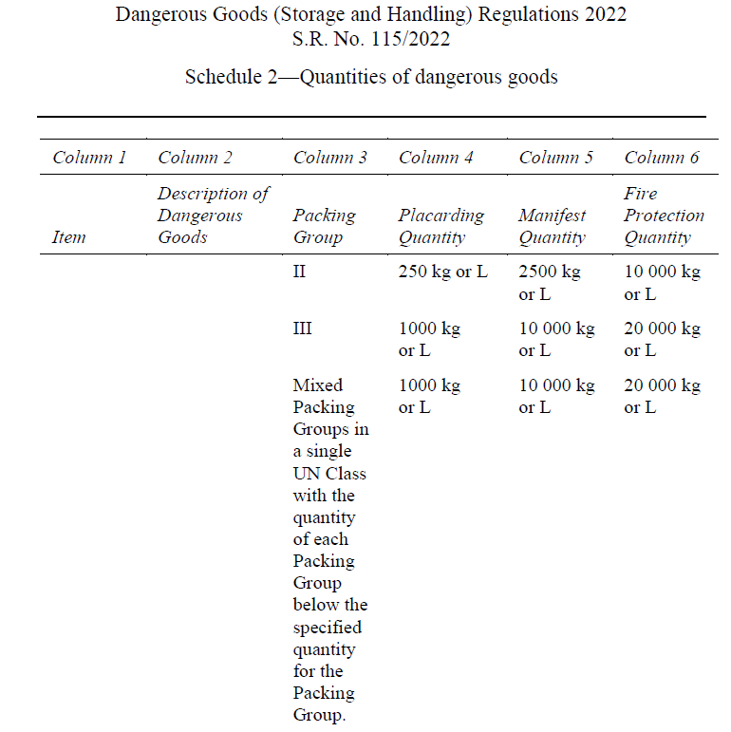
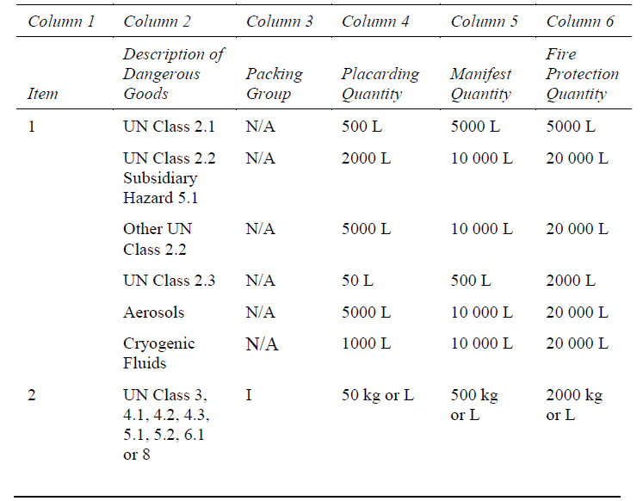
Schedule 2 (extract)

Slide 26
Threshold Quantities – WHS States
Categories based on GHS physical hazards, largely aligned with DG classes
Thresholds are slightly different
  Placarding Quantity
  Manifest Quantity
  There is no Fire Protection Quantity
The quantities are given in Schedule 11 of the WHS Regulations

Slide 27

WHS Regs Schedule 11 (extract)
Source: Commonwealth Work Health and Safety Regulations 2011, Schedule 11

Slide 28

Threshold Quantities – WA
Quantities are as per Dangerous Goods Safety (Storage and Handling of Non-explosives) Regulations, Schedule 1:
  Placarding Quantity
  Manifest Quantity
  10 x DG manifest quantity requires DFES Emergency Response Guide (except petrol stations and mine sites).
Continues under WA WHS legislation.

Slide 29
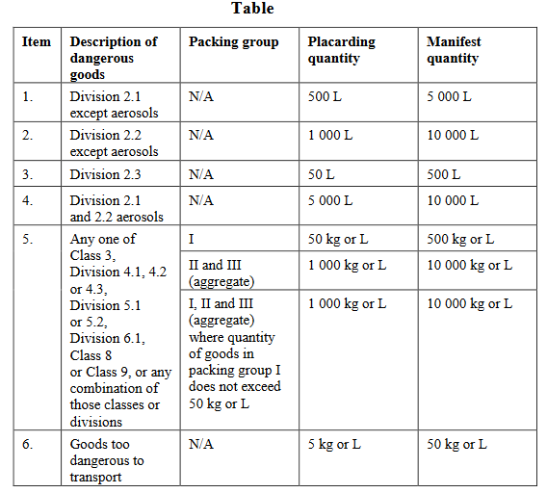
Threshold Quantities – WA (Schedule 1)
Source: WA Dangerous Goods Safety (Storage and Handling of Non-explosives) Regulations 2007, Schedule 1 — Quantities of dangerous goods

Slide 30
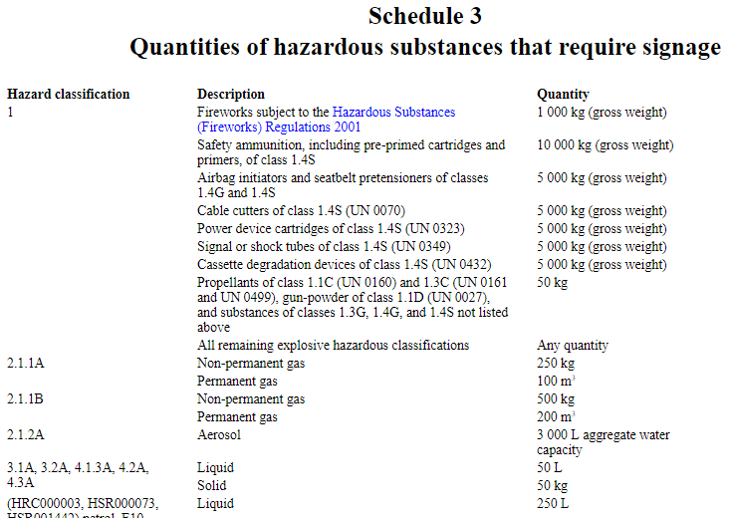

NZ HSW (HS) Regs
Schedule 4 Quantities of hazardous substances that require fire extinguishers
Schedule 5 Threshold quantities for emergency response plan

Slide 31
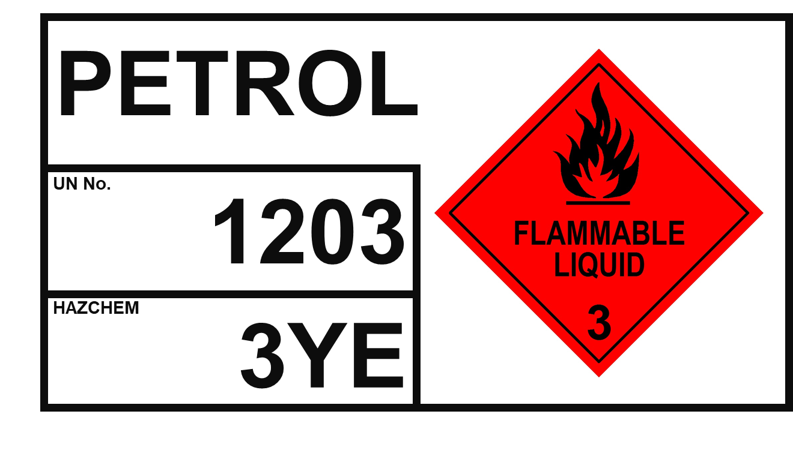
Quantity Measurement Bulk
Non liquid – the mass (kgs) the container is designed to hold
Liquid – the design capacity of the container in litres
  In example: 30,000 litres
Gas – total capacity of the container
Solids not in container – undivided mass in kgs
30,000 LITRES
10,000 LITRES

Slide 32
Quantity Measurement
Packaged
Non liquid – net mass (kgs) in container
Liquid – net capacity of the container
Gas – Total capacity of the container

Slide 33

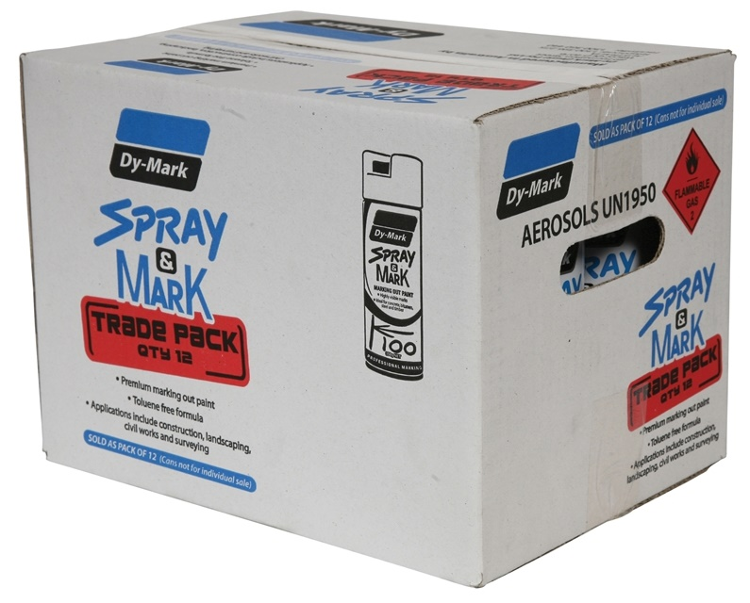
Quantity Measurement - Articles
The net quantity of that part of the article that is Dangerous Goods
12 x 350 g = 4,200 g = 4.2 Kg

Slide 34
Minor Storage
Quantities less than the placarding quantity
  Note: There may be several minor quantity stores on a site.
Ensure containers are properly labelled
Maintain Register and SDSs
Provide suitable PPE
Ensure adequate segregation
Ensure suitable spill management
Provide training
Provide security
Manage waste disposal

Slide 35

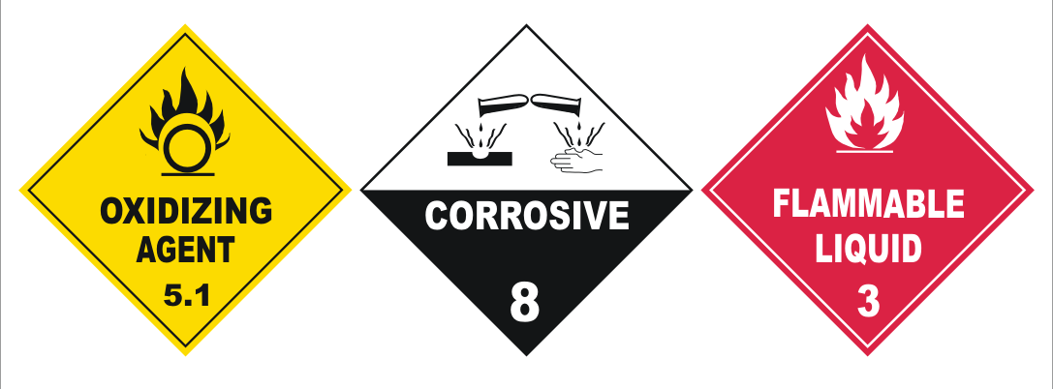
Placard Quantities
Placard site and storage facilities
Identify hazards
Perform risk assessment
Take risk control measures
  Storage and handling
  Transfer
  Segregation
  Ignition sources
  Spill control
  Ventilation

Slide 36
Manifest Quantity
Notification to workplace safety regulator
  VIC requires 2-yearly update to WorkSafe (changed from 5-yearly on 1 July 2021)
  Licence required in SA, WA
  See regulator websites in other States
Prepare Manifest
  Shows location of storage facilities and quantities in each store
Prepare written Emergency Plan
  (Approved by Fire Authority – VIC)

Slide 37
Dangerous Goods Manifest
TANK | PRODUCT | VOL. (L) | DG CLASS
1 | MEK | 10,000 | 3, PG II
2 | WHITE SPIRIT | 20,000 | 3, PG III
3 | WASTE OIL | 20,000 | C2
4 | HEATING OIL | 30,000 | C1
5 | BASE OIL 150 | 55,000 | C2
6 | BASE OIL 460 | 55,000 | C2`
8 | CAUSTIC SODA | 5,000 | 8, PG II
TRIPLE INTERCEPTOR
TRUCK EXIT
4
3
8
7. Gas bottle Storage
5
2
BLEND TANKS
WORK-SHOP
WAREHOUSE
LABORATORY
GAS METER
BT4
BT5
BT6
6
1
DRUM
STATION
FILLING LINE
OFFICES
WASTE STORAGE
BT1
FIRE
HYDRANT
BT2
BT3
9. DRUM STORAGE
CLASS 3 10,000 L CLASS 8 6,000 L
XYZ CHEMICALS
TRUCK ENTRANCE
EMPTY DRUMS
CAR PARKING

Slide 38
Fire Protection Quantity (VIC only)
Obtain written report from Fire Brigade re adequacy of fire protection services

Slide 39
DFES Emergency Response Guides (FES-ERGs – WA only)
Required at sites that store or handle more than 10 x manifest quantity (except petrol stations and mine sites).
Designed to provide essential information to the Department of Fire and Emergency Services (DFES) for use in an emergency at larger dangerous goods sites.

Slide 40
Segregation
Segregation of chemicals in a warehouse, is of critical importance to the manager and the operator.
Principally achieved by Class
Sub-hazards must also be considered when determining segregation
Notes:
40
MAKE SPECIAL MENTION OF -
AUSTRALIAN STANDARDS FOR STORAGE AND HANDLING OF CLASS EIGHT (CORROSIVES)
SUB-hazardS MUST BE TAKEN INTO CONSIDERATION.
GAS CYLINDERS SHOULD BE STORED OUTSIDE.
4.3 DANGEROUS WHEN WET MUST BE STORED IN A DRY STORE. IE NO SPRINKLERS.
POWDERS WITH AN EXPLOSION HAZARD TO BE STORED NEAR THE FLOOR.

Slide 41
Some interactions can be violent.
Nitric Acid (Class 8 - Corrosive/Class 5.1 Oxidising Agent) + Ethanol (Class 3 - Flammable Liquid)
will lead to an explosion with the liberation of fumes of nitrous oxide, acetaldehyde and formaldehyde.
Some interactions can liberate very poisonous gases.
Hydrochloric Acid (Class 8 - Corrosive) +
Sodium Cyanide (Class 6.1 - Poison)
will liberate extremely poisonous Hydrogen Cyanide.
Some interactions can liberate heat and acid fumes.
Sulphuric Acid (Class 8 - Corrosive ) +
Sodium Hydroxide (Class 8 - Corrosive)
will liberate much heat and fumes.
Notes:
41

Slide 42
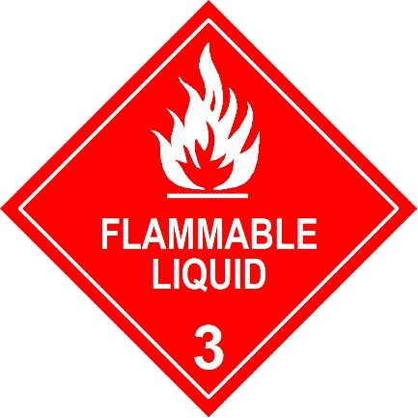


Segregation
Flammables
Corrosives – Acids
Oxidisers
Corrosives – Alkalis
Notes:
42

Slide 43
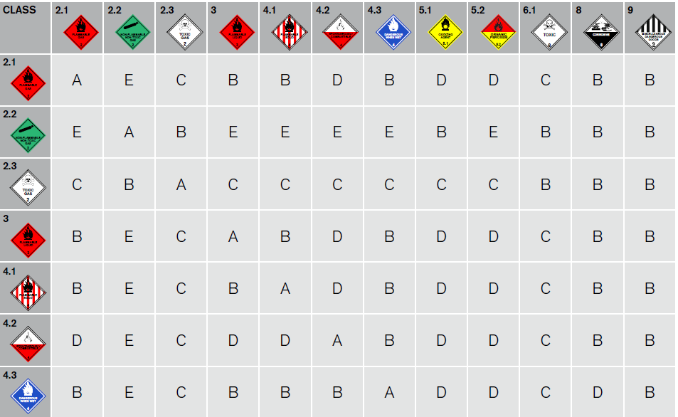
Segregation
See Appendix 2 of the Code of practice for the storage and handling of dangerous goods (VIC)
Notes:
43

Slide 44
Bunding – Package Storage
The capacity of the spillage containment compound shall be at least 100% of the volume of the largest package, plus 25% of the storage capacity up to 10 000 L, together with 10% of the storage capacity between 10 000 L and 100 000 L, and 5% above 100 000 L.
  Source: AS 1940:2017, part 4.4.3(d) Spillage containment
NOTE: Allowance must also be made for fire and storm water if appropriate
Notes:
44

Slide 45
Bunding – Bulk Storage
Notes:
45

Slide 46
Other matters to consider
Transit storage
Site plan
Hazmat box and its location

Slide 47
Placarding for Storage
There are four ‘types’ of placard under the Dangerous Good Regulations – these are:
  Outer warning placards
  Information placards for stated Dangerous Goods in tanks
  Information placards for stated Dangerous Goods in Packages; and
  Information placards for stated combustible liquids in tanks or packages

Slide 48
Outer Warning Placard
HAZCHEM
120 mm
100 mm Lettering
600 mm
Notes:
48

Slide 49
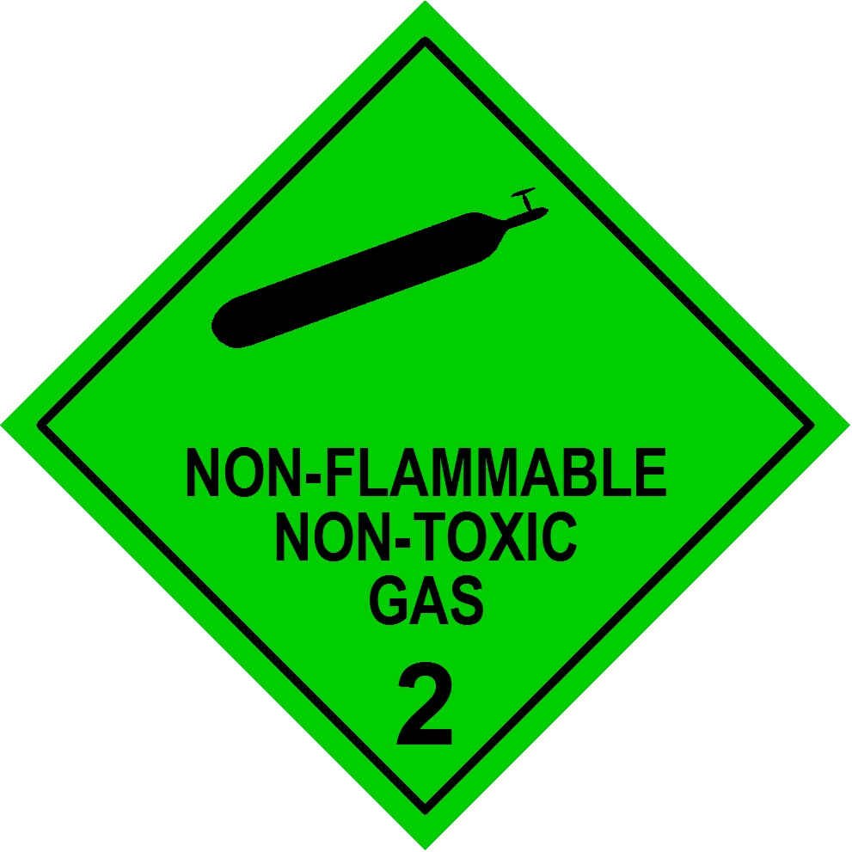
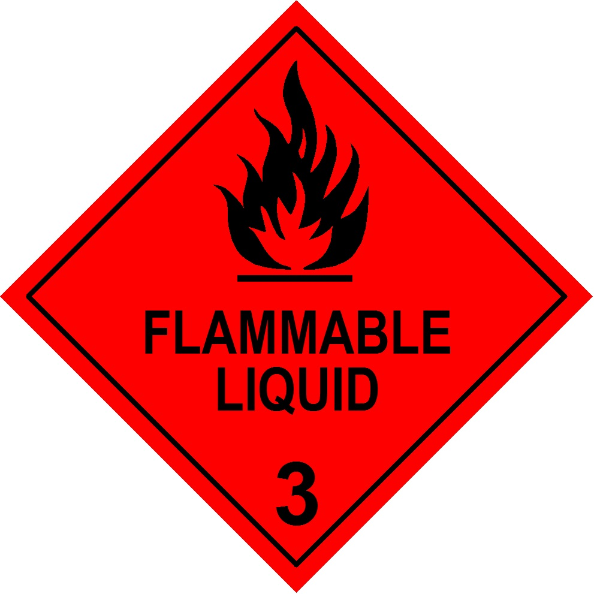


Package Store Placard
100 mm
Notes:
49

Slide 50

Bulk Tank Placard
AMMONIA,
ANHYDROUS
50 mm
50 mm
UN No.
1005
400 mm
100 mm
200 mm
HAZCHEM
2RE
100 mm
150 mm
800 mm
Notes:
50

Slide 51
Combustible Liquid Placard
(GHS: Flammable Liquid Category 4)
COMBUSTIBLE LIQUID
100 mm Lettering
Placard quantity is 10,000 litres
Applies to diesel fuel storage (above-ground only)
Notes:
51

Slide 52


New Zealand Signage Format
HAZCHEM
HAZCHEM
IN CASE OF FIRE
CALL 111 – ASK
FOR FIRE
DEPARTMENT
IN CASE OF
SPILL CALL
AUCKLAND
CITY COUNCIL
POLLUTION
HOTLINE
09 377 3107
IN EMERGENCY DIAL 111, FIRE, POLICE OR AMBULANCE
For urgent medical advice: National Poisons Centre Dial 0800 POISON (0800 764 766)
TOXIC TO AQUATIC LIFE
CONTAIN SPILLS, PROTECT WATERWAYS
COMBUSTIBLE LIQUID
KEEP AWAY FROM IGNITION
SOURCES – NO SMOKING
TOXIC TO AQUATIC LIFE
CONTAIN SPILLS, PROTECT WATERWAYS
1,000L - <10,000L BULK DIESEL
>10,000L BULK DIESEL

Slide 53
Segregation Exercise

Slide 54


Slide 55
Road and Rail Transport
Packaging
Placard loads
EIPs
Limited and Excepted Quantities
Shipping documentation
Bulk transfer

Slide 56
ADG uses container based approach
Large packagings
  Capacity ≤3 m³, containing
    articles or inner packaging with net mass >400 kg, or
    total capacities >450 L
Bulk containers (solids, >1 m³ capacity)
Portable tanks (>450 L)
IBCs (Intermediate Bulk Containers, ≤3,000 L)
Tank vehicles
Multiple element gas containers (MEGCs)
Gas cylinders
Pressure drums

Slide 57
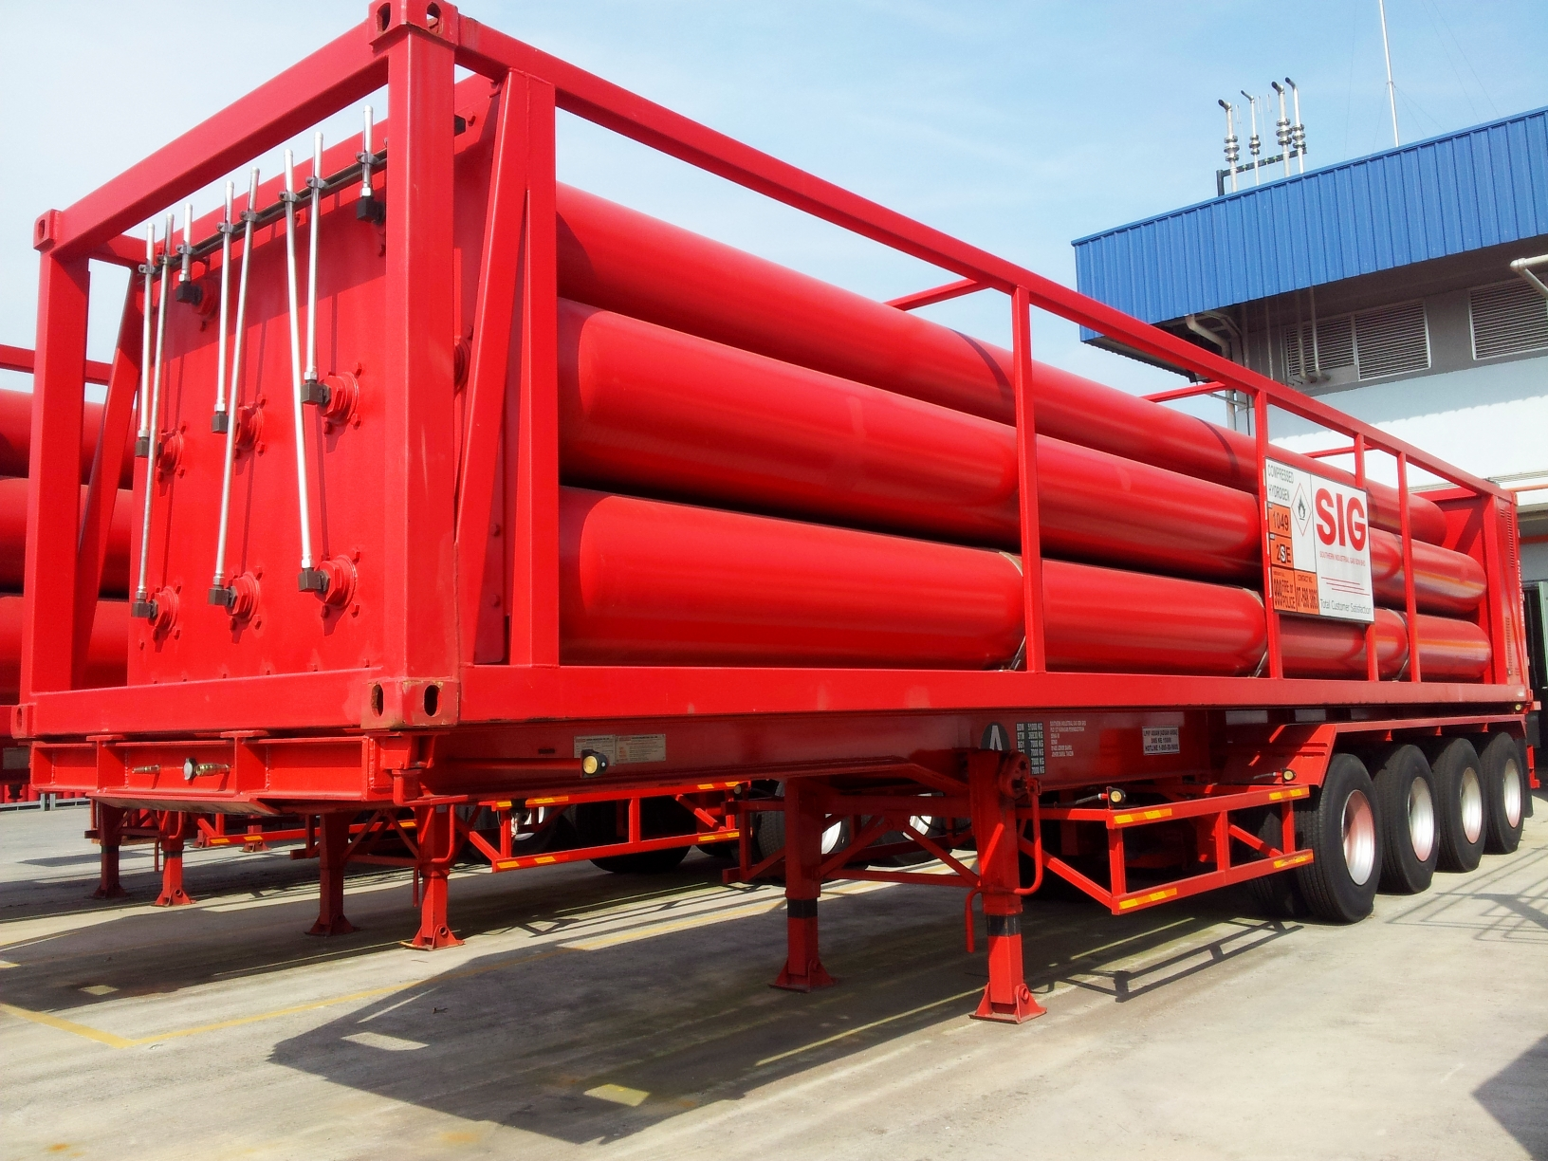
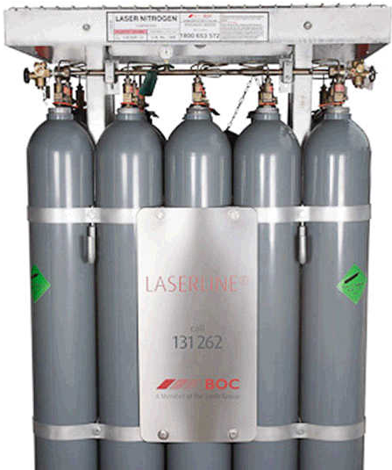
MEGCs

Slide 58
Aggregate Quantity
The total of
  the number of kilograms of:
    solid dangerous goods; and
    articles (including aerosols); and
  the number of litres or kilograms, whichever is used in the transport documentation to describe the goods, of liquid dangerous goods; and
  the total capacity in litres of receptacles containing dangerous goods of Class 2 (except aerosols).

Slide 59
Limited & Excepted Quantities
  The ADG has adopted rules for transport of Dangerous Goods in limited quantities without vehicle placarding, licensing and other controls
  Chapter 3.4: “the transport of certain small quantities of dangerous goods may be conditionally exempt from the Regulations and this Code”.
  Chapter 3.5 “Excepted quantities of dangerous goods of certain classes, other than articles, meeting the provisions of this Chapter are not subject to any other provisions of this Code”.
  Specific provisions apply to inner, intermediate and outer packaging, and to segregation

Slide 60

Limited & Excepted Quantities
  Limited Quantities are listed in Column 7a of Table 3.2.3
  Excepted quantities are in Table 3.2.3 column 7b
Limited Quantity mark
100 mm
Excepted Quantity mark

Slide 61
  Limited & Excepted Quantities

Slide 62
Limited & Excepted Quantities & Concessional Limited Quantities
In 2017 ADG7.5 replaced Retail Distribution Loads with Concessional Limited Quantities (CLQ), including domestic consumables dangerous goods, requirements.
In 2018 ADG7.6 introduced Mixed Packet (Lower Risk) Dangerous Goods provisions, and Personal Care Products in consumer packaging provisions.

Slide 63
ADG7.7 simplifies Limited Quantity requirements further
LQ sub-categories removed:
  Concessional Limited Quantity
  Mixed Packet (Lower Risk) Dangerous Goods
  Personal Care Products in Consumer Packaging.
DG Transport Documentation no longer required
  Documentation to state load “Contains Dangerous Goods Packed in Limited Quantities”.
Placarding requirements also change.

Slide 64
Domestic Consumable DGs
LQ segregation, overpack and documentation concessions extend to Domestic Consumable DGs that are packed and intended for retail distribution, which are defined as including:
  party poppers;
  sparklers and bon-bons (UN0337),
  domestic smoke detectors (UN 2911),
  lighters and lighter refills (UN1057) or
  portable fire extinguishers with compressed or liquefied gas up to 23kg gross weight (UN 1044).
See LQ guidance document in webinar attachments.

Slide 65
Placard load – LQ or DC
A load that contains Limited quantity and / or domestic consumable DGs that :
  Includes aggregate quantity of any 1 UN number from a single place of consignment:
    ≥ 2,000 L or Kg
  Does not include aggregate quantity of any 1 UN number from a single place of consignment:
    ≥ 8,000 L or Kg
  See ADG 7.7 Table 5.3.2
If consigning a mixed load of LQ/DC and fully regulated DC, see ADG 7.7 Table 5.3, NOTE 5, or p. 14-15 of NTC Guidance document, Consigning and transporting dangerous goods packed in limited quantities.

Slide 66

Overpacks
An enclosure containing one or more Dangerous Goods packages – e.g.:
  pallet secured by shrink wrapping or similar,
  protective outer packaging such as a crate.
The word “OVERPACK” should be displayed in lettering at least 12 mm high.
  NOT required if the overpack is intended only for transport by road or rail within Australia.

Slide 67
Overpacks
Packages in an overpack must be secured to minimise damage during transport.
Incompatible dangerous goods must not be transported together in an overpack, unless limited quantity provisions are met.
Overpack must be labelled with proper shipping name, UN number and marks for all DGs,
  OR
With the Limited Quantity mark.

Slide 68
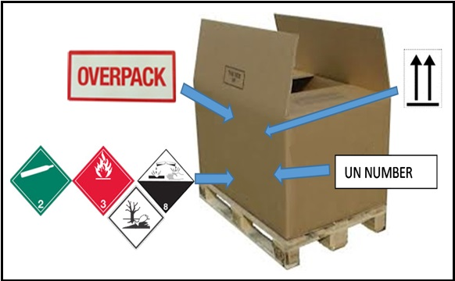
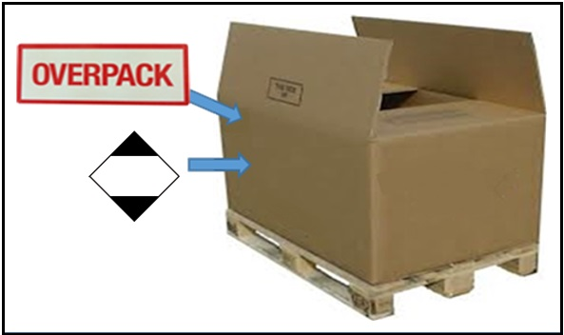
Overpacks

Slide 69
Intermediate packaging
Compulsory for limited quantities …
  … of class 8, PGII in glass, porcelain or stoneware
  … in inner packagings that are liable to break or be easily punctured, e.g. glass, porcelain, stoneware or certain plastics.
    ADG7.7 clause 3.4.2.3
Absorbent material required for liquids

Slide 70
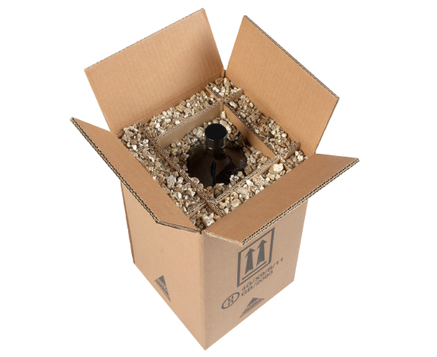
Intermediate packaging

Slide 71
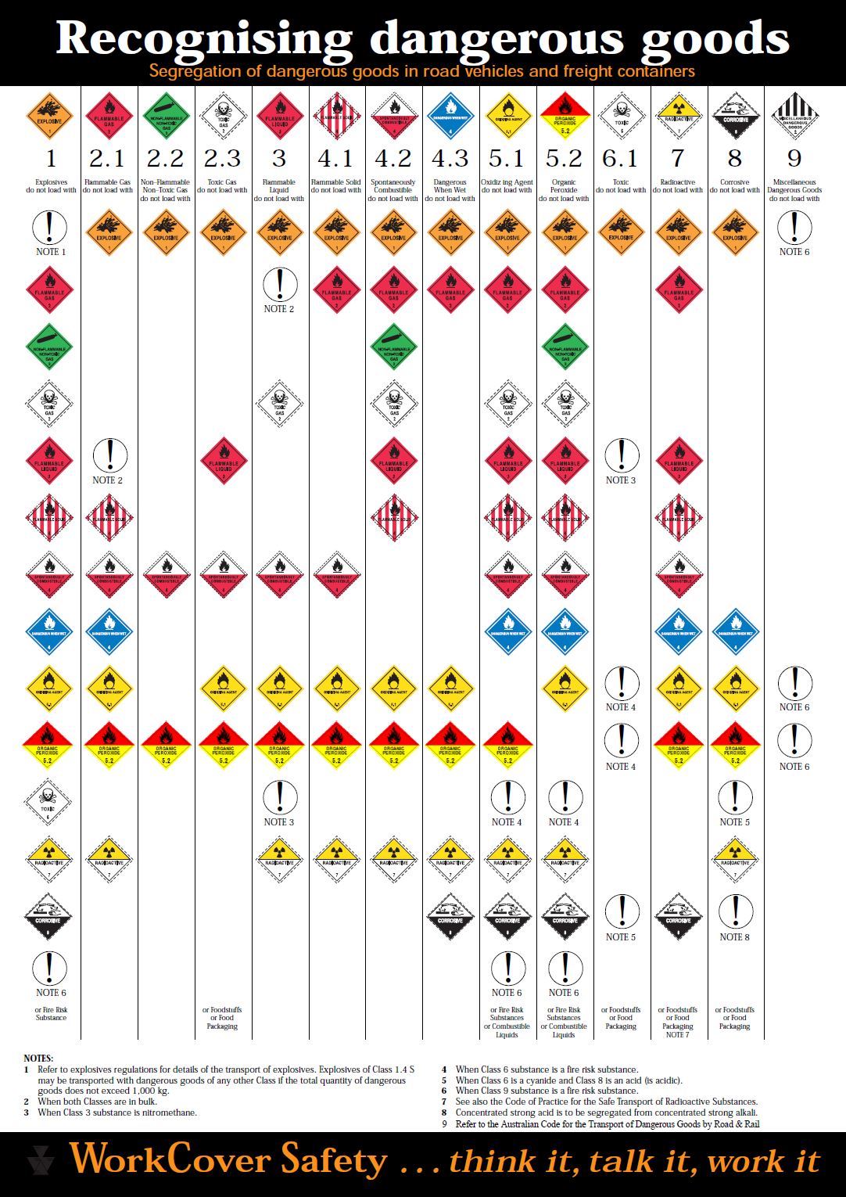
Segregation in Placarded Loads

Slide 72
Licencing
A DG driver’s licence AND a DG vehicle licence are required to transport DGs:
  In a receptacle with capacity > 500 L or KG
  A licence is not required to transport DGs in IBCs with a total capacity > 3,000 L that are not packed or unpacked on the vehicle.

Slide 73
Placard load (other than LQ/DC)
Dangerous goods in a receptacle with a capacity of >500 L or Kg, OR | Aggregate quantity of DGs of ≥250 L or Kg that includes — Division 2.1 Flammable Gases (except aerosols), OR Division 2.3 Toxic Gases; OR Dangerous goods in any class of Packing Group I, OR
Division 6.2 Class A – all quantities Other classes – ≥ 10 KG/L, OR | Aggregate quantity of DGs (other than LQ) of ≥1,000 L or Kg

Slide 74
Placarding of Package Vehicles
A vehicle carrying a Placard Load must be placarded with:
  If one Class:
    A Class Label (and sub-hazard if applicable) at the FRONT & REAR
  If more than one Class:
    Mixed Class Label
      OR
    all Individual Class Labels
Non-placard loads may be placarded

Slide 75
Vehicle Placarding – Packaged DGs
RIGID TRUCK
SEMI-TRAILER
TRUCK-TRAILER
B-DOUBLE

Slide 76
Placarding of Bulk Vehicles
Rule 1:
  All vehicles carrying Bulk Dangerous Goods must be placarded
Rule 2:
  The placards must be clearly visible at all times during transport

Slide 77
Placarded Bulk Vehicles
Bulk Dangerous Goods
Front of the vehicle
  Class label (and sub-hazard if applicable)
  If more than one class,
    The mixed Class Label, or
    Individual Class Labels
Both sides and the rear
  Emergency information panels - either;
    Individual EIP
    Mixed load (refined petroleum product) EIP, or
    Multi-load EIP

Slide 78
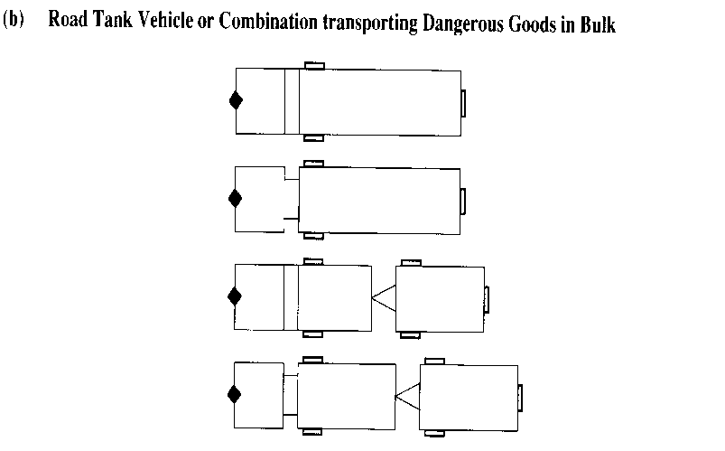
Vehicle Placarding
Bulk DGs (including IBCs)
RIGID TRUCK
SEMI-TRAILER
TRUCK-TRAILER
B-DOUBLE

Slide 79
Emergency Information Panel (EIP)
PETROL
100 mm
250 mm
UN No.
1203
600 mm
100 mm
HAZCHEM
3YE
100 mm
IN EMERGENCY, DIAL
000, POLICE OR FIRE BRIGADE
SPECIALIST ADVICE
XYZ FUEL COMPANY 1800-005-411
800 mm
Notes:
79

Slide 80

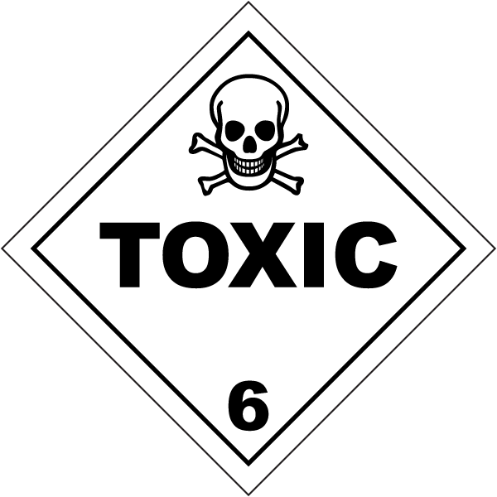
Emergency Information Panel (EIP)
NITRIC ACID,
RED FUMING
50 mm
200 mm
50 mm
UN No.
2032
HAZCHEM
2PE
150 mm
IN EMERGENCY, DIAL
000, POLICE OR FIRE BRIGADE
SPECIALIST ADVICE
ABC CHEMICAL COMPANY 1800-116-522
Notes:
80

Slide 81
Placarding Mixed Load Vehicles
Dangerous Goods in both Bulk and Packages aboard same vehicle
Same Class
  Mark as for bulk of that Class
Different Classes
  Front and rear – mixed Class Label
  Both sides and rear
    Emergency information panels appropriate to the bulk Dangerous Goods aboard

Slide 82
Use of Multi-Load EIPs
Where a multi-compartment tanker contains Dangerous Goods that are not the same –
  All EIPs to be Multi-load
Where a vehicle carries portable bulk containers holding different Dangerous Goods –
  Enclosed vehicle – All Panels Multi-load
  Open vehicle – Rear panel Multi-load (provided EIPs on containers visible from sides)

Slide 83

Mixed Load EIP
250 mm
UN No.
MULTI-LOAD
HAZCHEM
3YE
IN EMERGENCY, DIAL
000, POLICE OR FIRE BRIGADE
SPECIALIST ADVICE
XYZ FUEL COMPANY 1800-005-411
Notes:
83

Slide 84
Placements of EIPs
Side Panels
On a vehicle (includes tankers):
  As close as possible to the front
On a Bulk Container or Freight Container:
  Any position
Rear Panel
  Any position as long as clearly visible
  All EIPs must be in a substantially vertical plane
  Lower edge at least 450mm above the ground

Slide 85
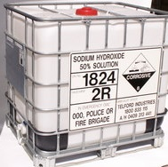
EIPs on Bulk Containers
IBCs may have smaller Emergency Information Panels
  i.e. 400mm x 300mm
If EIPs attached to a Bulk Container are visible from both sides – no further EIPs needed on the sides of the truck or trailer
Fully complying EIP, i.e. 800 mm x 600 mm is required on the rear

Slide 86
Placarding Bulk Containers
Must be placarded on each side with an emergency information panel (EIP)
An EIP must also be visible from the rear
Notes:
86

Slide 87
Placarding Freight Containers carrying a Placard Load
Packaged Dangerous Goods
Same Class and UN No
  Class and sub-hazard (if applicable) & UN No
Same Class but different UN Nos
  Class and sub-hazard (if applicable)
Different Classes
  Either or both of –
    Mixed Class labels
    Class labels for each of the Dangerous Goods
Bulk Dangerous Goods
  Emergency information panels

Slide 88
Removal of EIPs
EIPs must be removed from containers which have been purged
Rear EIP on a bitumen spray vehicle may be removed during spraying operations

Slide 89

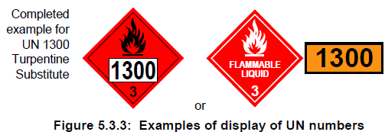

Container Placarding for transport by sea and air
This type of labelling is required for transport by sea (IMDG Code) and air (IATA / ICAO).
It DOES NOT apply to consignments of dangerous goods being transported only by road or rail within Australia.
Intermodal containers can be transported to and from ports if they have been placarded in accordance with IMDG or IATA Regulations.
See ADG 7.7 part 5.3.2.1.

Slide 90

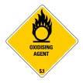




NZ Road Transport Placards
Loaders and drivers must placard vehicles and freight containers … whenever the load is over 50 kilograms or 50 litres.
The only exception to this is if the load is dangerous goods in excepted quantities or excepted packages of radioactive material, transported in accordance with clause 2.9 of the rule.
Examples of dangerous goods placards:
Source: https://nzta.govt.nz/driver-licences/getting-a-licence/licences-by-vehicle-type/transporting-dangerous-or-hazardous-goods/dangerous-goods-carried-by-transport-operators/

Slide 91
Vehicle Placarding Exercise

Slide 92
Container Placarding for transport by sea and air
European and some South American intermodal bulk containers may display a Hazard identification number in the top half of an orange panel, with the 4-digit UN number in the bottom half.
The first digit indicates the primary hazard, the second and third digit generally indicate secondary hazards.
  Doubling of a digit indicates an intensification of that particular hazard (i.e. 33, 66, 88)
  Where the hazard associated with a substance can be adequately indicated by a single figure, this is followed by a zero. (i.e., 30, 40, 50)
  • A hazard identification number prefixed by the letter 'X', indicates that the substance will react dangerously with water. (i.e., X88)

Slide 93
Shipping Documentation
Required for all DG loads except LQ / DC
Must be:
  In English
  In hard copy
  Carried in an emergency information container

Slide 94
Shipping Documentation (Cont…)
DG and non-DG may be entered on the same document; however, DG must be entered first
On a multi-trailer vehicle (e.g. B-Double), documents should indicate which goods are stored on each unit
Tankers should carry a run-sheet indicating approximately how much product is remaining

Slide 95
Shipping Documentation (Cont…)
Documentation is made up of two parts
  Product Information
  Emergency Information

Slide 96
Product Information
Proper shipping name
Class and Sub-hazard (if applicable)
UN No.
Packing Group
Total quantity
For Bulk: (Portable)
    Description of each type of container e.g. ‘IBC’ and number of containers
For Packages:
    Description of each type of package e.g. ‘drum’ and number of packages

Slide 97
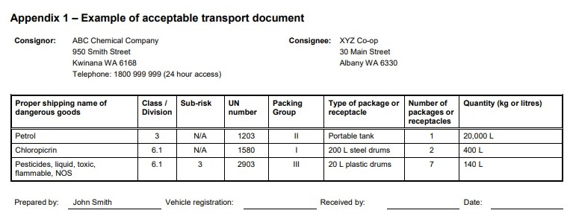
Example transport document

Slide 98
Emergency Information
Approved types include:
  Dangerous Goods – Initial Emergency Response Guide (HB 76:2010, SAI Global)
  Australian & New Zealand Emergency Response Guide Book 2021
    Replaces Australian Emergency Response Guidebook 2018
Australian emergency contact information MUST be included

Slide 99
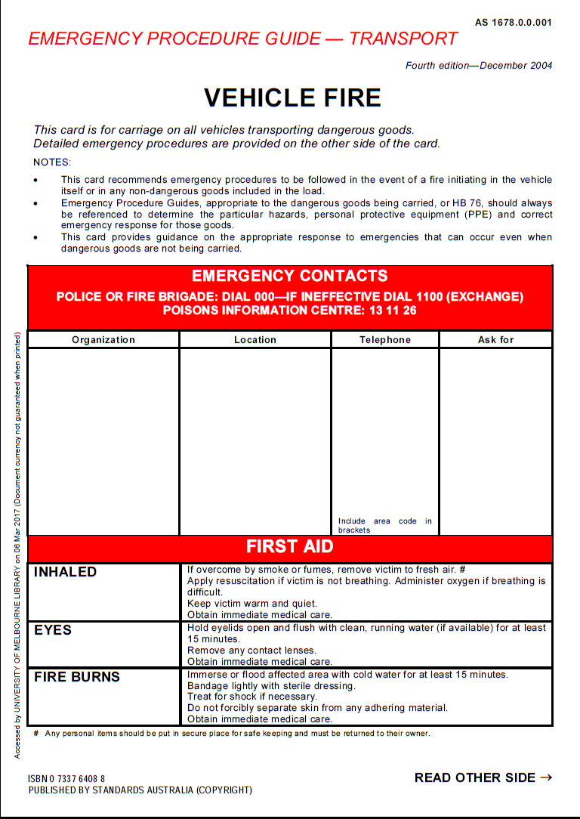
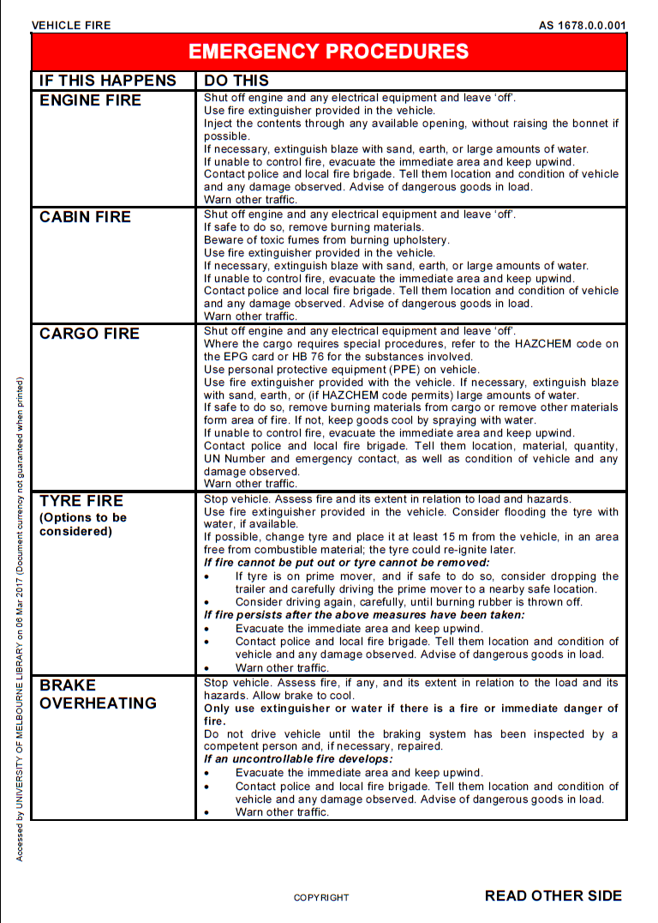
Dangerous Goods – Initial Emergency Response Guide

Slide 100
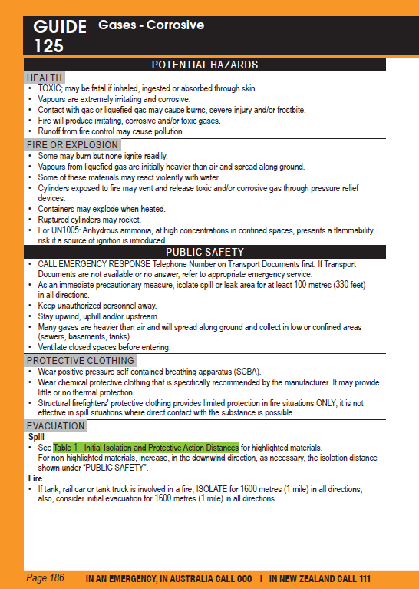
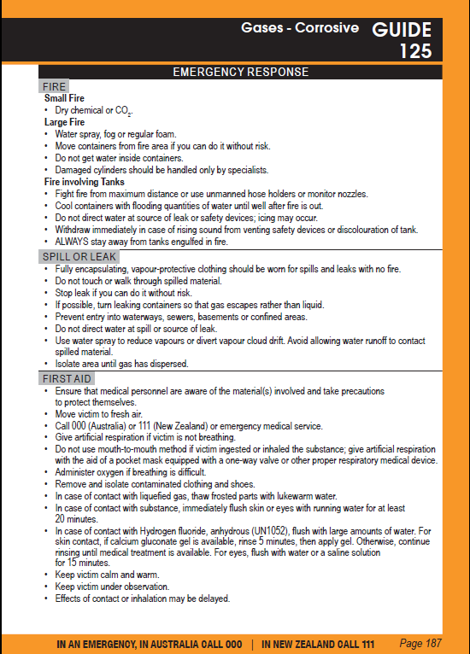
Australian & New Zealand Emergency Response Guide Book 2021

Slide 101
Transfer of Bulk Dangerous Goods
Positioning vehicles for transfer
Control of ignition sources during transfer of flammables
Bonding
Filling levels
Prevention of movement during transfer
Person to remain at vehicle
No person in cabin
Notes:
101

Slide 102
Transfer of Bulk Dangerous Goods
Is the Responsibility of the Transferor –
who is usually the Driver
  Now includes transfer of bulk solids
Notes:
102

Slide 103
Ullage Space in Container
Any transport tank containing liquid either:
  Single compartment of more than 8600 litres or
  Multiple compartments any one of which exceeds 8600 litres
Must not be driven with an ullage space of between 20% and 85%
This rule does not apply to Class 2 Dangerous Goods or Cutback Bitumens
Notes:
103

Slide 104
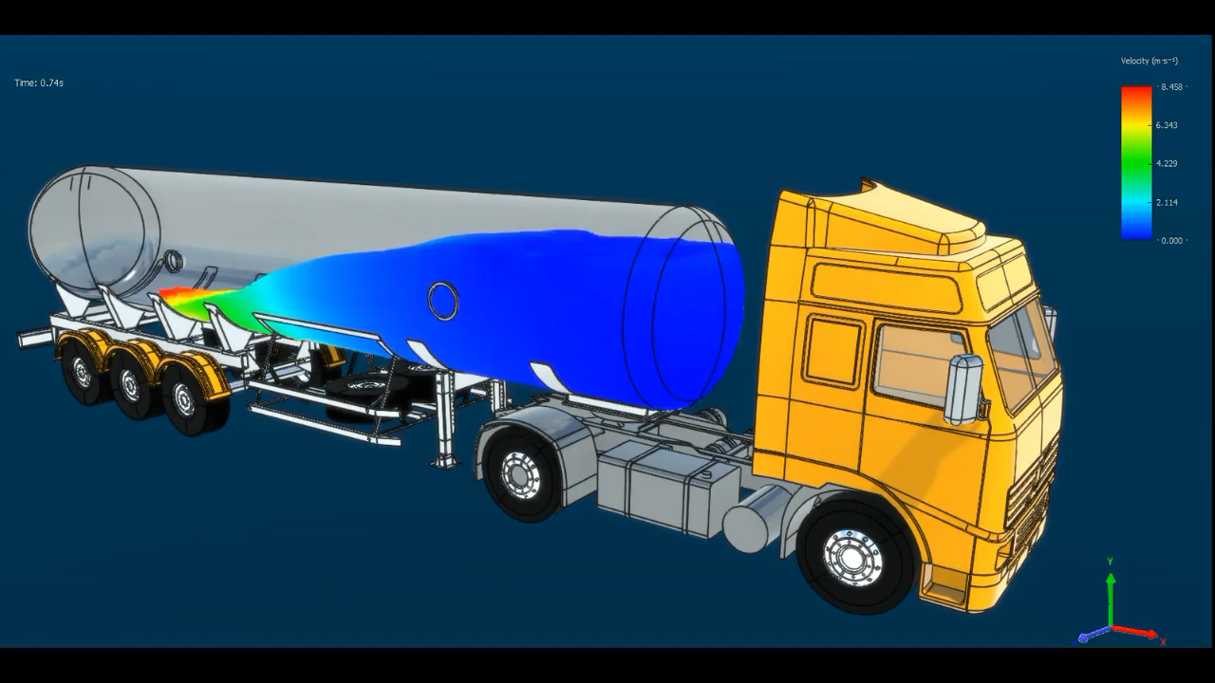
Ullage Space in Container
Source: https://www.linkedin.com/posts/alex-gover-3a2a87139_a-unique-look-at-the-fluid-dynamics-in-a-ugcPost-6565175346348474368-JBb4

Slide 105
Positioning of Vehicle
Two options:
Position so it can be driven away in a forward direction –
  or, if not possible,
so it can be driven away with minimal manoeuvring
Notes:
105

Slide 106
Before Transfer
Ensure
  There is sufficient space in the tank to take what is being delivered
  Transfer hose is connected to the correct fill point
Notes:
106

Slide 107
Hoses
No hoses to be run across areas accessible to vehicles, unless access is stopped.
Notes:
107

Slide 108
Ignition Sources
No smoking or carrying of matches or lighters, on vehicles carrying Dangerous Goods of Classes (or with sub-hazards) of 2.1, 3, 4 or 5 in bulk
Notes:
108

Slide 109
Ignition Sources during Transfer
Every hose connection point must be separated from ignition sources by not less than:
  10 metres for Class 2.1
  15 metres for Class 3, being filled into a tanker
  8 metres for Class 3, being discharged from a tanker
  8 metres for Class 4 or 5
Notes:
109

Slide 110
Electrical Bonding – Class 3
Receiving tank to be electrically bonded to discharging tanker
Bonding lead to be connected when tank being filled or emptied
Exception – underground tanks
Notes:
110

Slide 111
Vehicle Engines
For Class (or sub-hazard) 2.1, 3 or 4, the vehicle engine must be stopped before hose connections are made.
For all Dangerous Goods, the engine must remain stopped during discharge …
  … UNLESS required for pumping.
Notes:
111

Slide 112
During Transfer
No person in the cabin
Person must remain at the vehicle, where the operation can be observed and all valves and equipment can be operated.
Notes:
112

Slide 113
After Transfer
Make sure all valves have been closed and closures replaced
Walk around vehicle
Notes:
113

Slide 114
URL - additional information
Australian Dangerous Goods Code (ADG )
  http://www.ntc.gov.au/heavy-vehicles/safety/australian-dangerous-goods-code/
Safe Work Australia
  www.safeworkaustralia.gov.au
National Transport Commission – ADG Code
  https://www.ntc.gov.au/codes-and-guidelines/australian-dangerous-goods-code
UN Model Regulations for the Transport of Dangerous Goods
  https://unece.org/info/publications/pub/364867
Global Harmonisation System (GHS) – UNECE
  https://www.unece.org/trans/danger/publi/ghs/ghs_welcome_e.html
Labelling of Agricultural and Veterinary chemicals
  https://apvma.gov.au/registrations-and-permits/labelling-codes
Poisons Schedule (SUSMP)
  https://www.tga.gov.au/publication/poisons-standard-susmp
Notes:
114

Slide 115
URL - additional information
EPA NZ – Hazardous substances classification
  https://www.epa.govt.nz/industry-areas/hazardous-substances/new-zealands-new-hazard-classification-system/
WorkSafe New Zealand – Hazardous Substances
  https://www.worksafe.govt.nz/topic-and-industry/hazardous-substances/
Hazardous Substances Toolbox
  https://www.hazardoussubstances.govt.nz/
NZ Land Transport Agency
  https://nzta.govt.nz/resources/rules/dangerous-goods-2005-index/
NZ Health and Safety at Work (Hazardous Substances) Regulations
  https://www.legislation.govt.nz/
Notes:
115

Slide 116
Australian & New Zealand Standards
  AS 1940–2017 The storage and handling of flammable and combustible liquids
  AS 2243.2:2021 Safety in laboratories, Part 2: Chemical aspects and storage
  AS 3780–2008 The storage and handling of corrosive substances
  AS/NZS 3833:2007 The storage and handling of mixed classes of dangerous goods, in packages and intermediate bulk containers
  AS 4332–2004 (R2016) The storage and handling of gases in cylinders
  AS/NZS 4452:1997 The storage and handling of toxic substances
  AS/NZS 4681:2000 The storage and handling of Class 9 (miscellaneous) dangerous goods and articles
  AS/NZS 5026:2012 The storage and handling of Class 4 dangerous goods
  NZS 5433:2020 Transport of dangerous goods on land
  SNZ HB 5433:2021 UN dangerous goods list

Slide 117
Sources of information
Physical inspection
Internal and external audits
Employee knowledge and expertise
Trade journals
WorkSafe alerts and publications
Incident /injury records
Industry associations
Notes:
117

Slide 118
Sources of information
Product information
Technical data sheets
Manufacturers instruction manuals
Personal contacts
By asking ‘What if ?’
Brainstorming
Notes:
118

Slide 119
AEBN SERIES 2: Dangerous Goods and Hazardous Substances Workshop Webinar
5 April 2023
Presented by
Australian Environment Business Network (AEBN)
National Office
100 Douglas Pde Williamstown Vic 3016 (PO Box 588 Altona Vic 3018)
T +61 3 9397 2511 | E aebn@aebn.com.au www.aebn.com.au

